Slide 1

NUCLEAR MATTER DENSITY DISTRIBUTIONS OF THE LIGHT WEAKLY BOUND NUCLEI
B URAZBEKOV A DENIKIN | N ITACO
DUBNA STATE UNIVERSITY
LUIGI VANVITELLI UNIVERSITY
JOINT INSTITUTE FOR NUCLEAR RESEARCH
LXX INTERNATIONAL CONFERENCE "NUCLEUS – 2020. NUCLEAR PHYSICS AND ELEMENTARY PARTICLE PHYSICS. NUCLEAR PHYSICS TECHNOLOGIES"

Slide 2
Content
Why the Density Distribution nuclear matter is important?
Objects of studying: ⁶He, ⁶Li and ⁹Be
The three body wave function
The Density Distribution of nuclear matter within the three body model
Results and discussions
⁶He, ⁶Li
⁹Be
Conclusion

Slide 3
Why the DD nuclear matter is important?

Slide 4
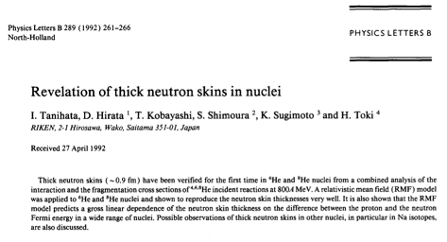
neutron skins in ⁶He and ⁸He nuclei
the Relativistic Mean Field model
Tanihata, I., et al. "Revelation of thick neutron skins in nuclei." Physics Letters B 289.3-4 (1992): 261-266.

Slide 5
A Two-neutron transfer reaction
α (⁶He, α) ⁶He
Oganessian, Yu Ts, V. I. Zagrebaev, and J. S. Vaagen. "“Di-Neutron” Configuration of 6 He." Physical review letters 82.25 (1999): 4996.

Slide 6
Objects of studying: ⁶He, ⁶Li and ⁹Be

Slide 7
The three body nuclei
сluster structure
plenty nuclear reactions
interaction potentials of internal clusters
n
p
α
⁶He
⁶Li
⁹Be

Slide 8
the three body model

Slide 9
the Schrödinger equation
Hamiltonian of the system
expansion of the wave function into basis
multiplying bra
from the left side
one gets
Matrix form of the Schrödinger equation for non-orthogonal basis:
where

Slide 10
the Hamiltonian
Kinetic energy
Sack-Biedenharn-Breit N𝛼-potential
Ali-Bodmer 𝛼𝛼-potential
Pauli Projector

Slide 11
the basis function
- full WF
x₃
- sum of components
y₁
y₃
- spin angular part
x₁
x, y – Jacobi
coordinates
-neutron
-alpha particle
- radial part

Slide 12
the density distribution function of nuclear matter

Slide 13
The function for the 3BS:
⁹Be on relative Jacobi coordinate sets with cyclically particle permutations taking into account a size of sub-alpha particles:
referring to the (i,jk) Jacobi coordinates set:
referring to the (j,ki) Jacobi coordinates set:
Final analytical expression depending on only R:
using certain expression

Slide 14
results

Slide 15
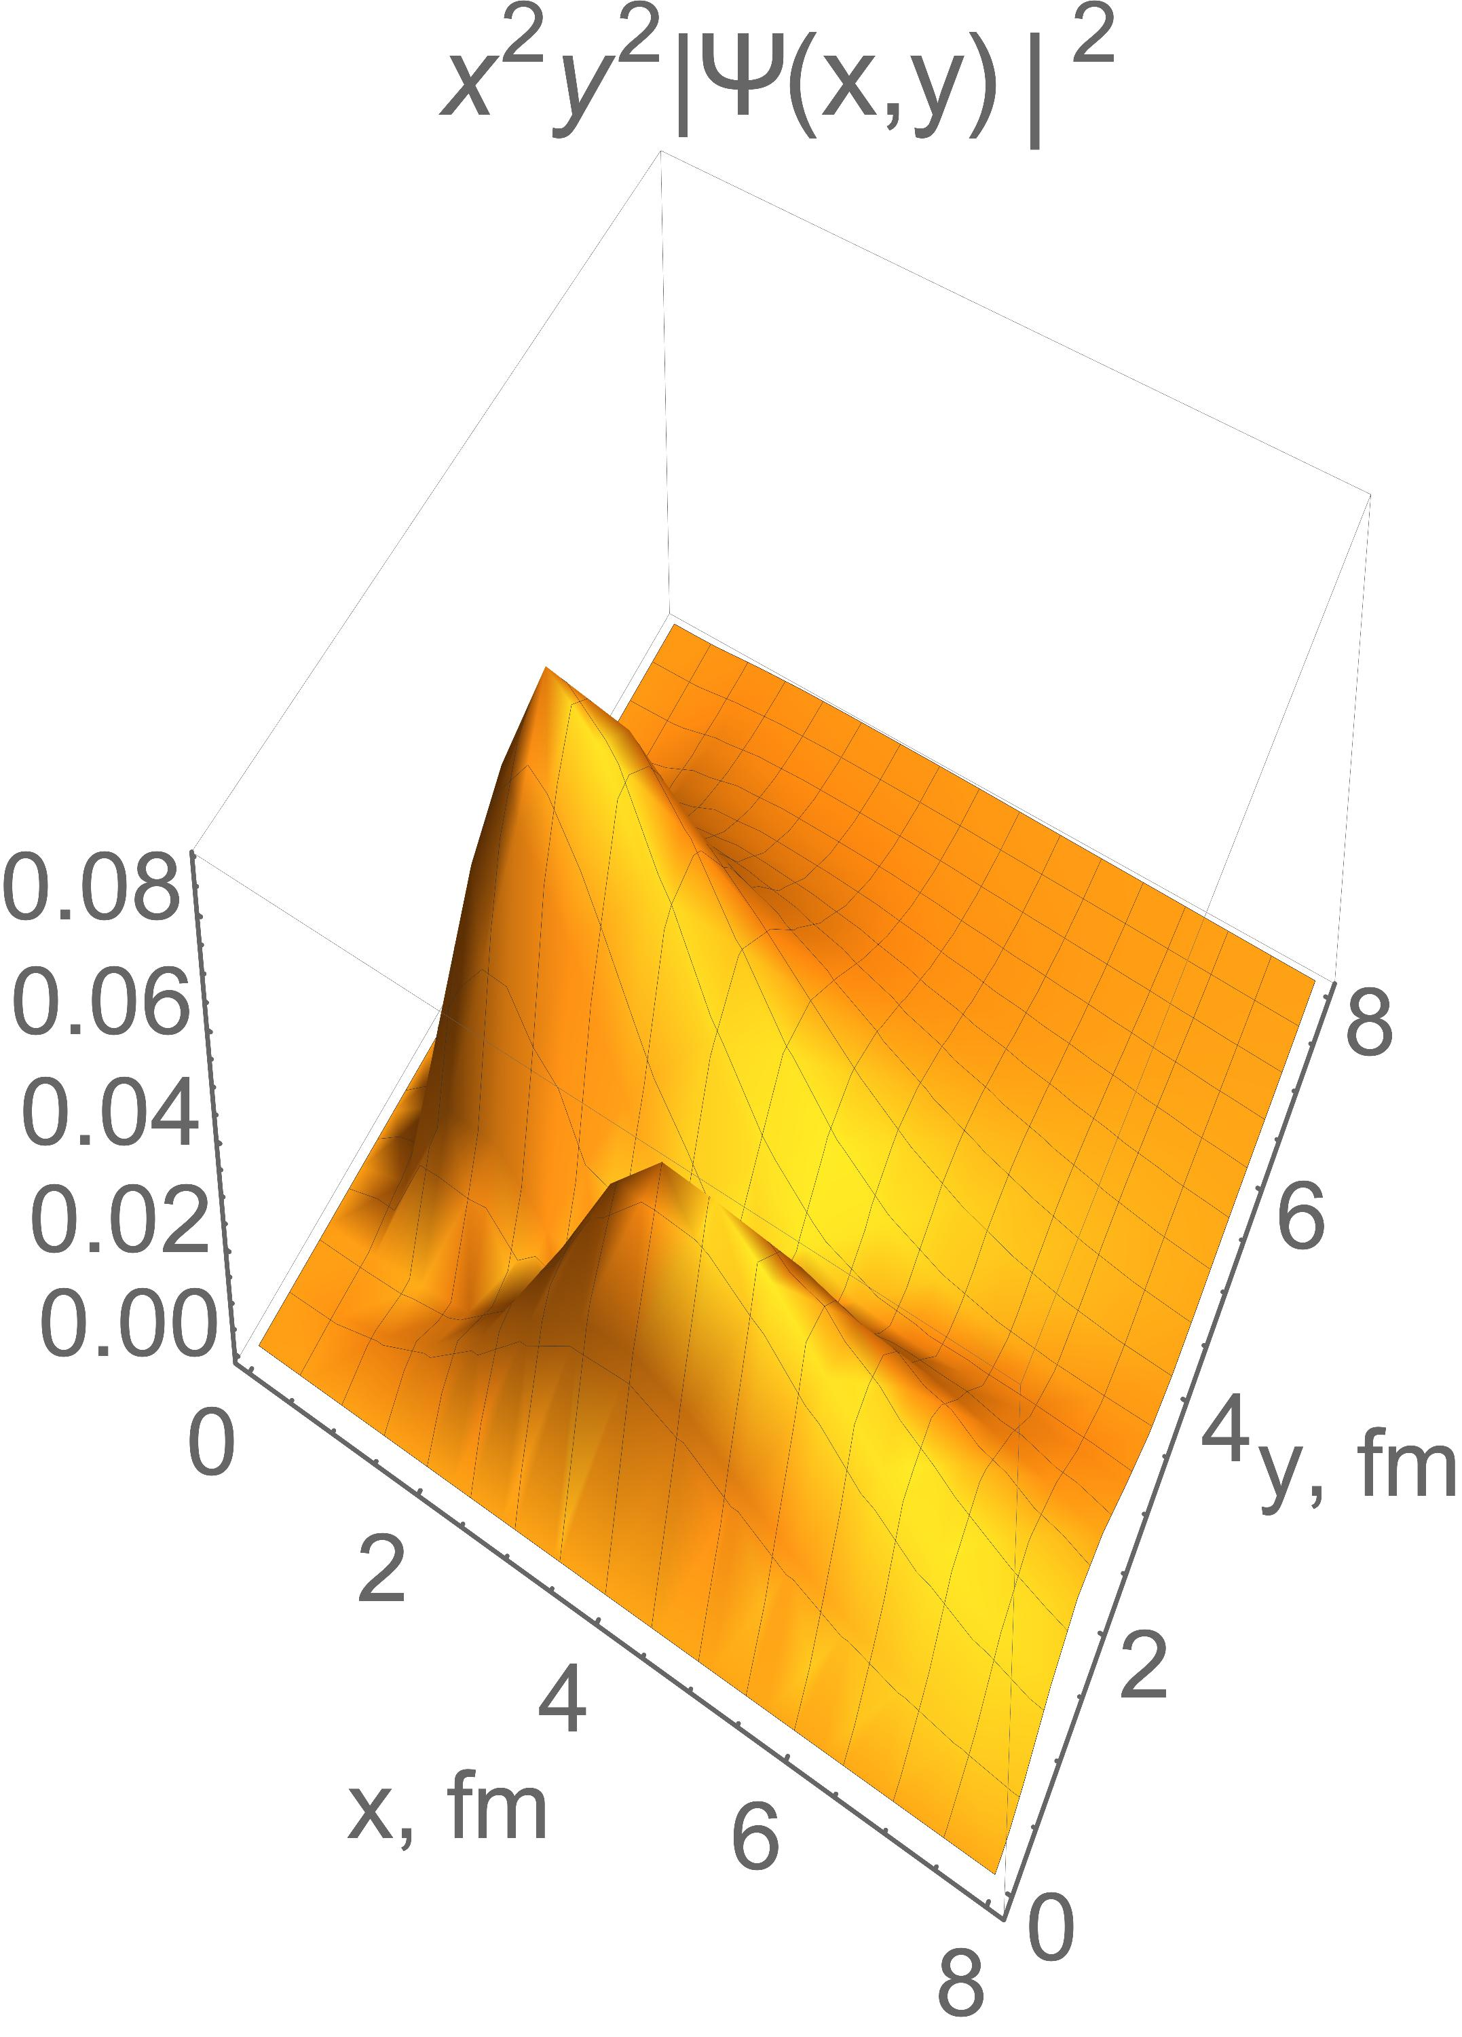
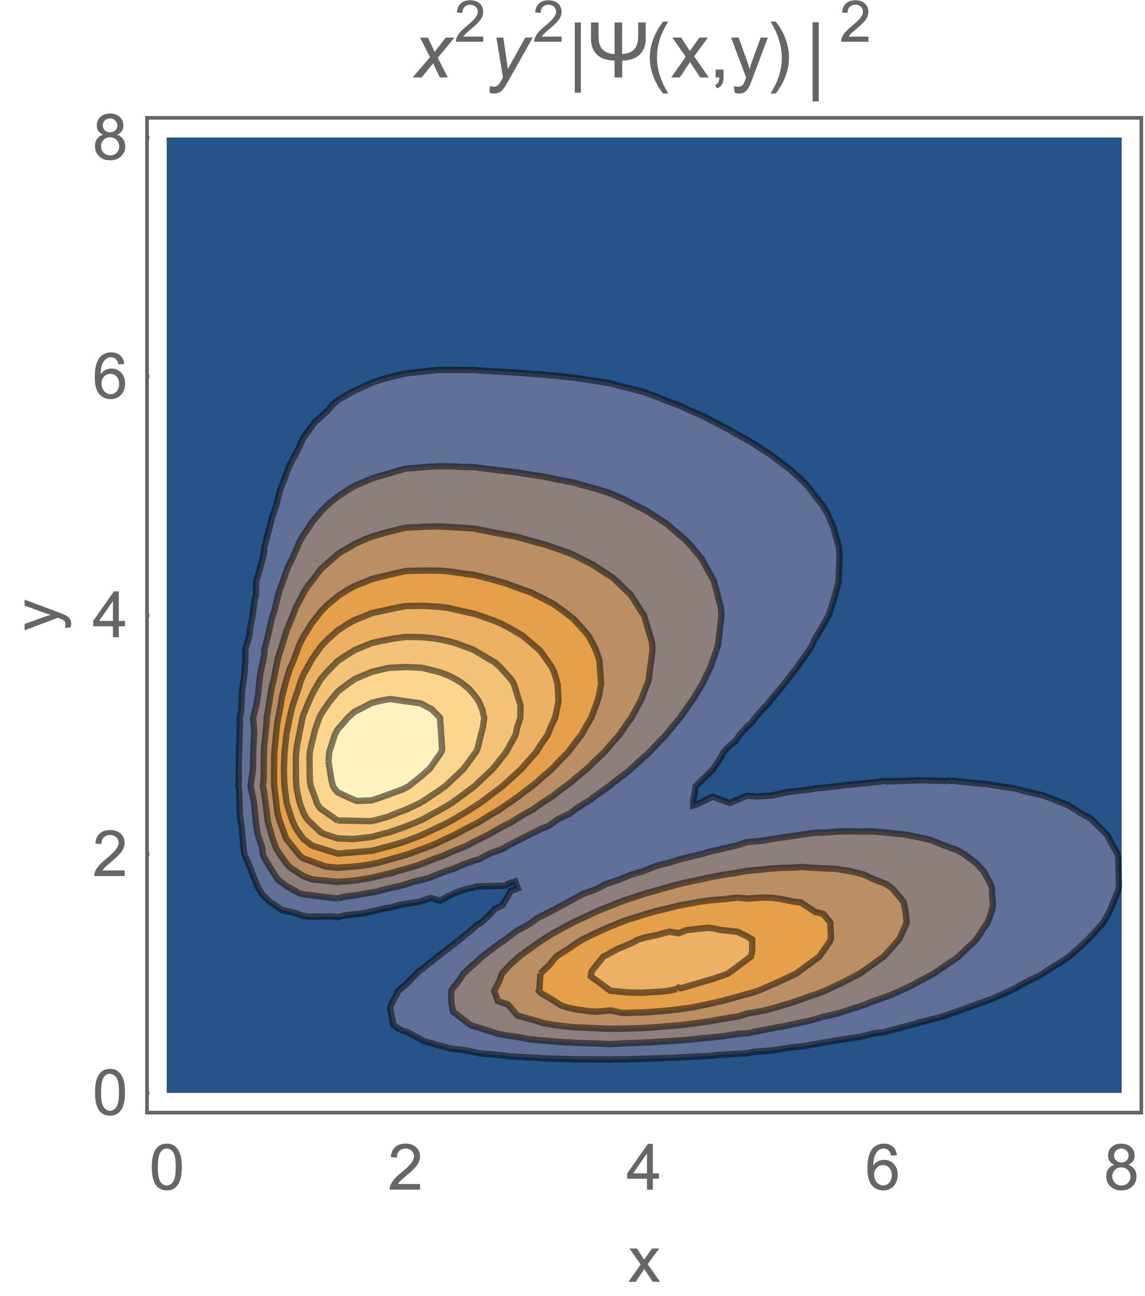
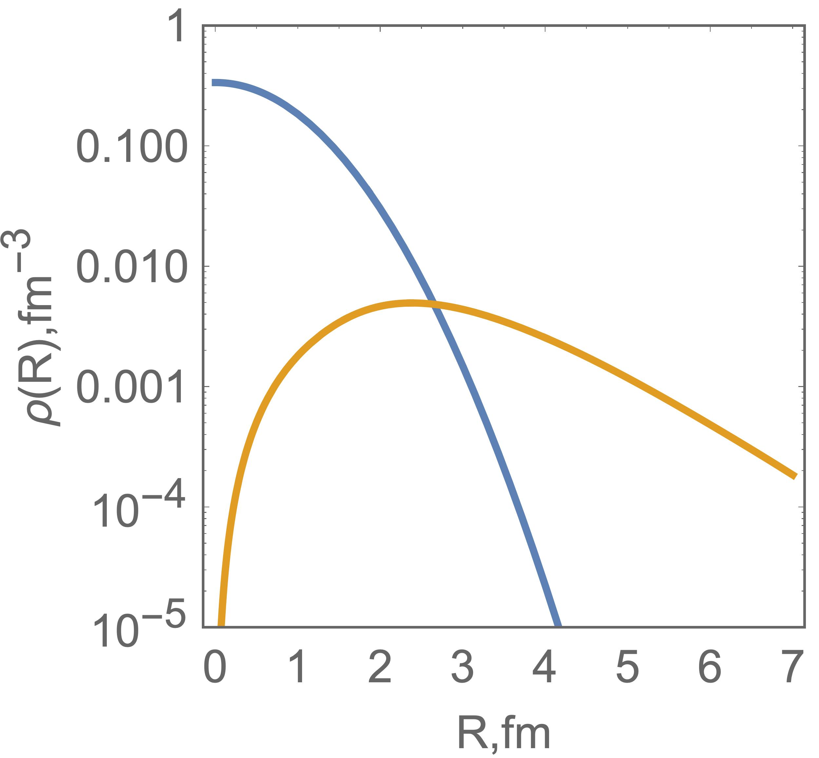
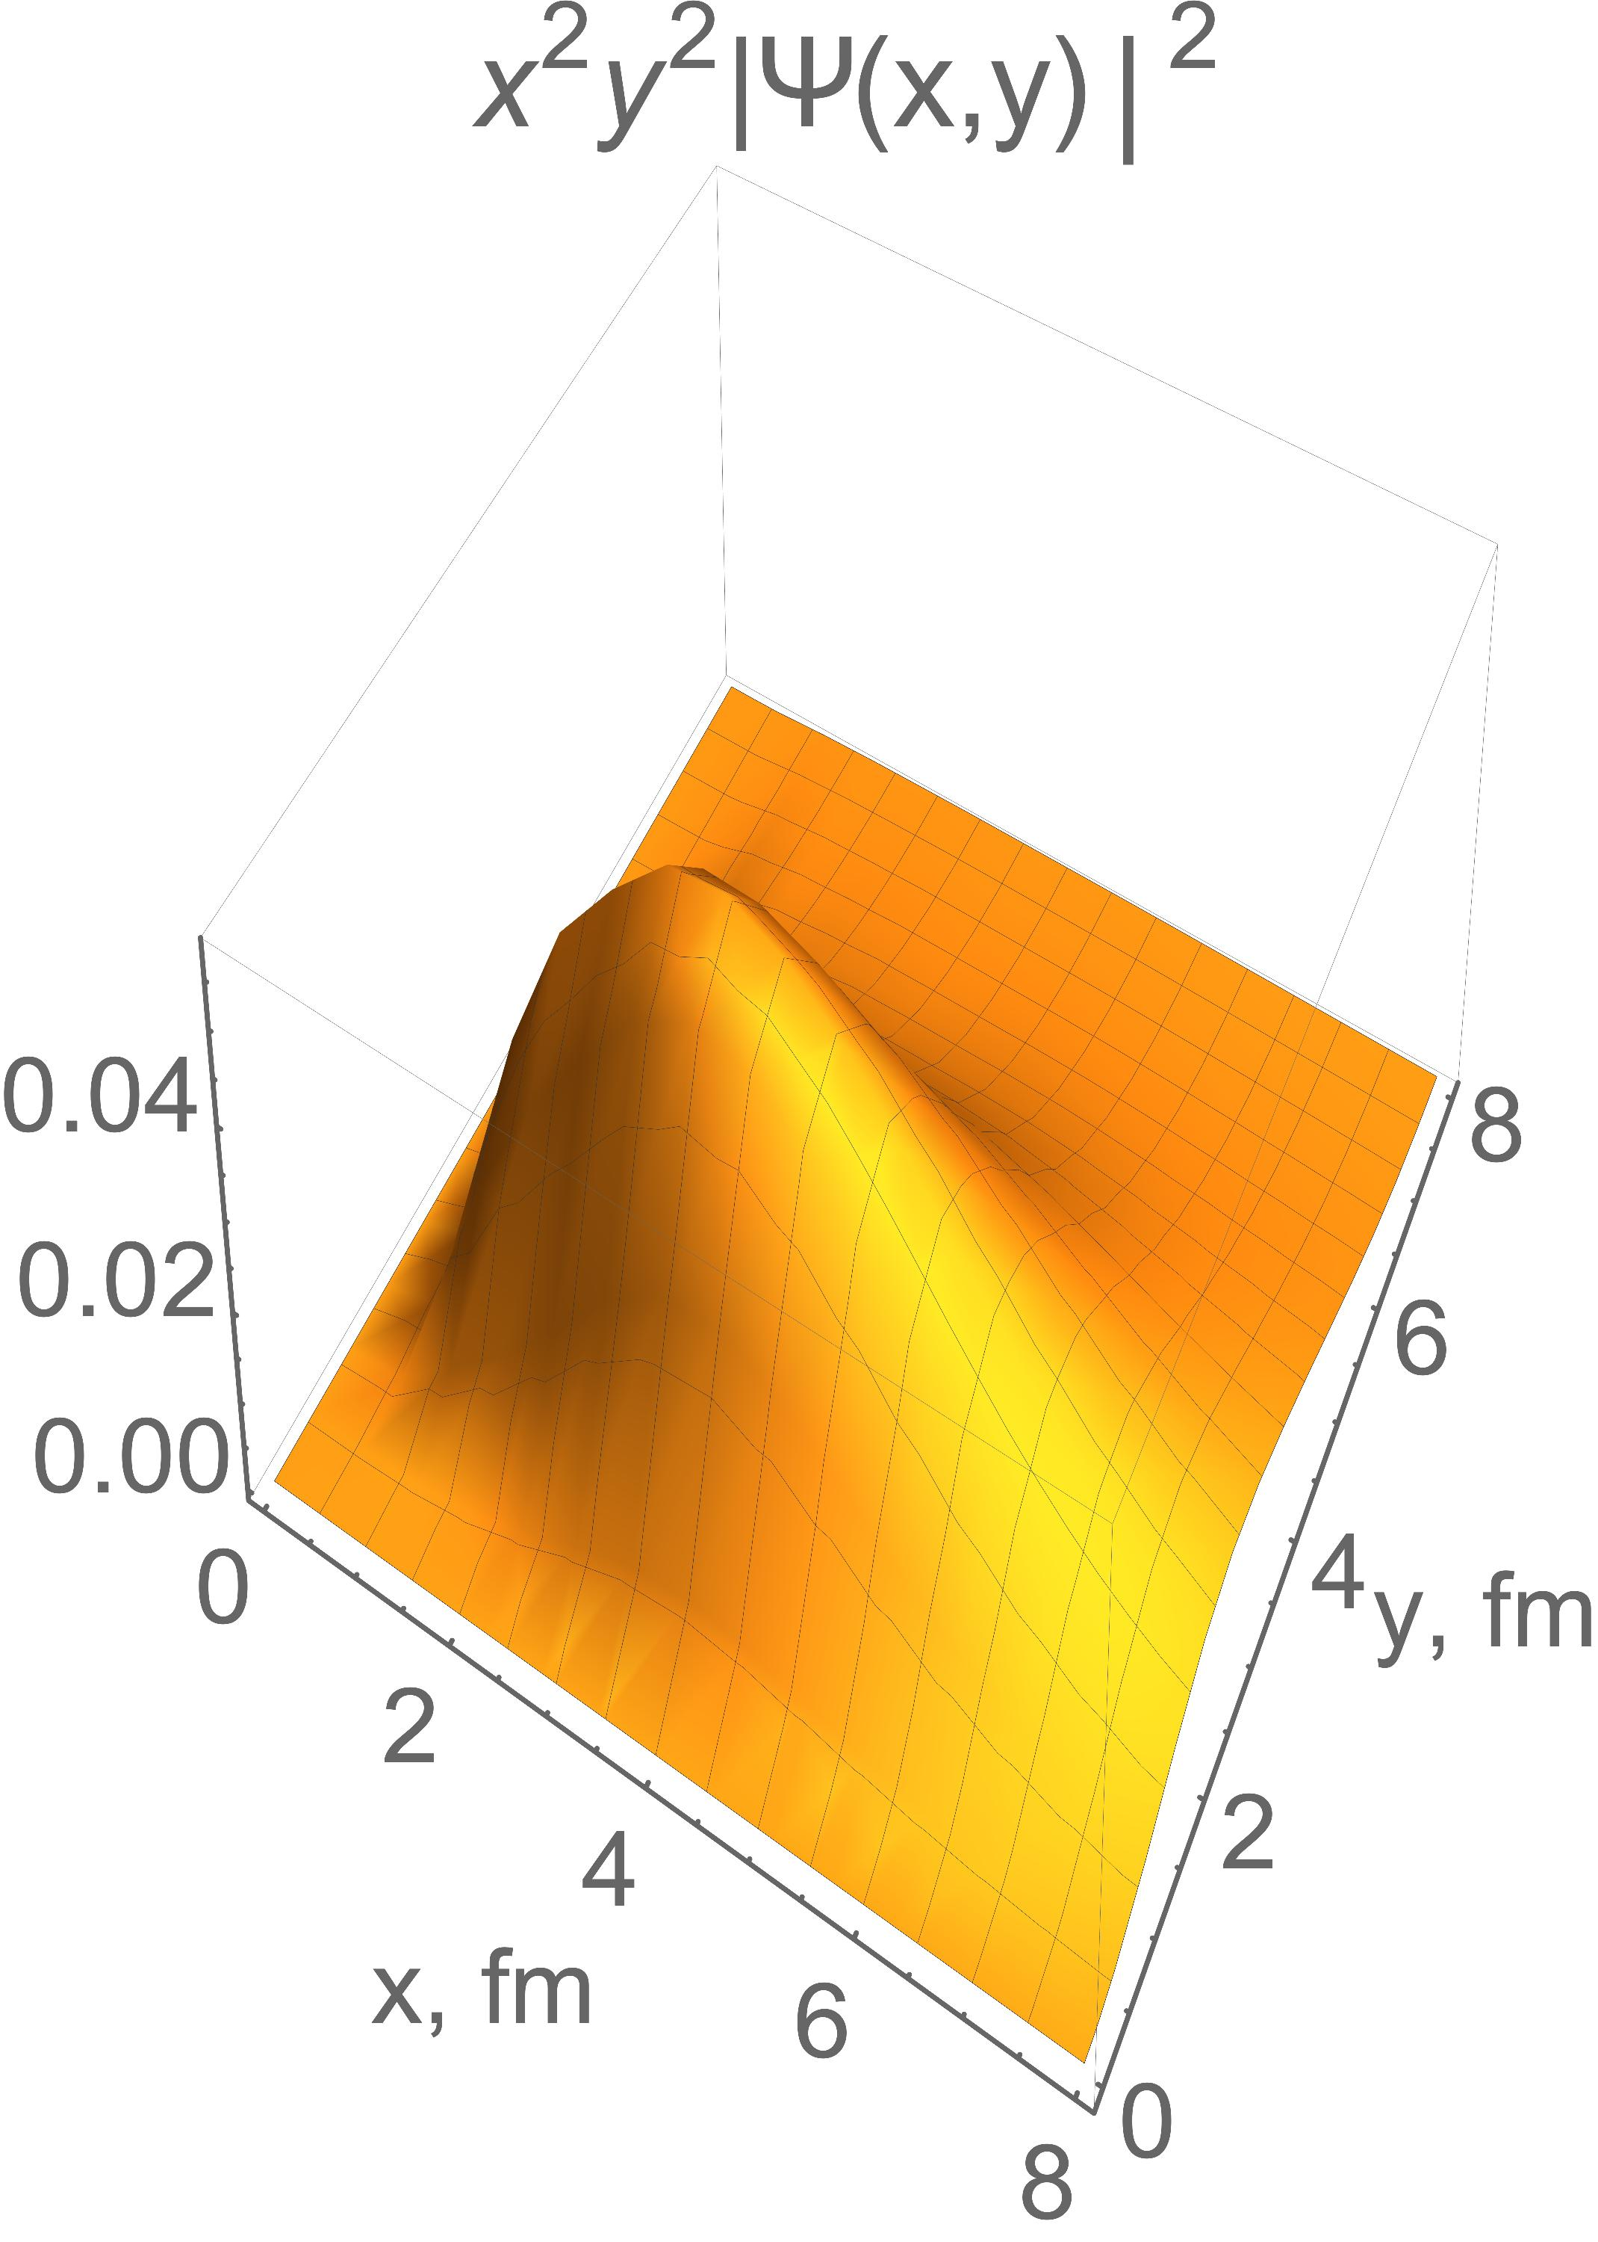
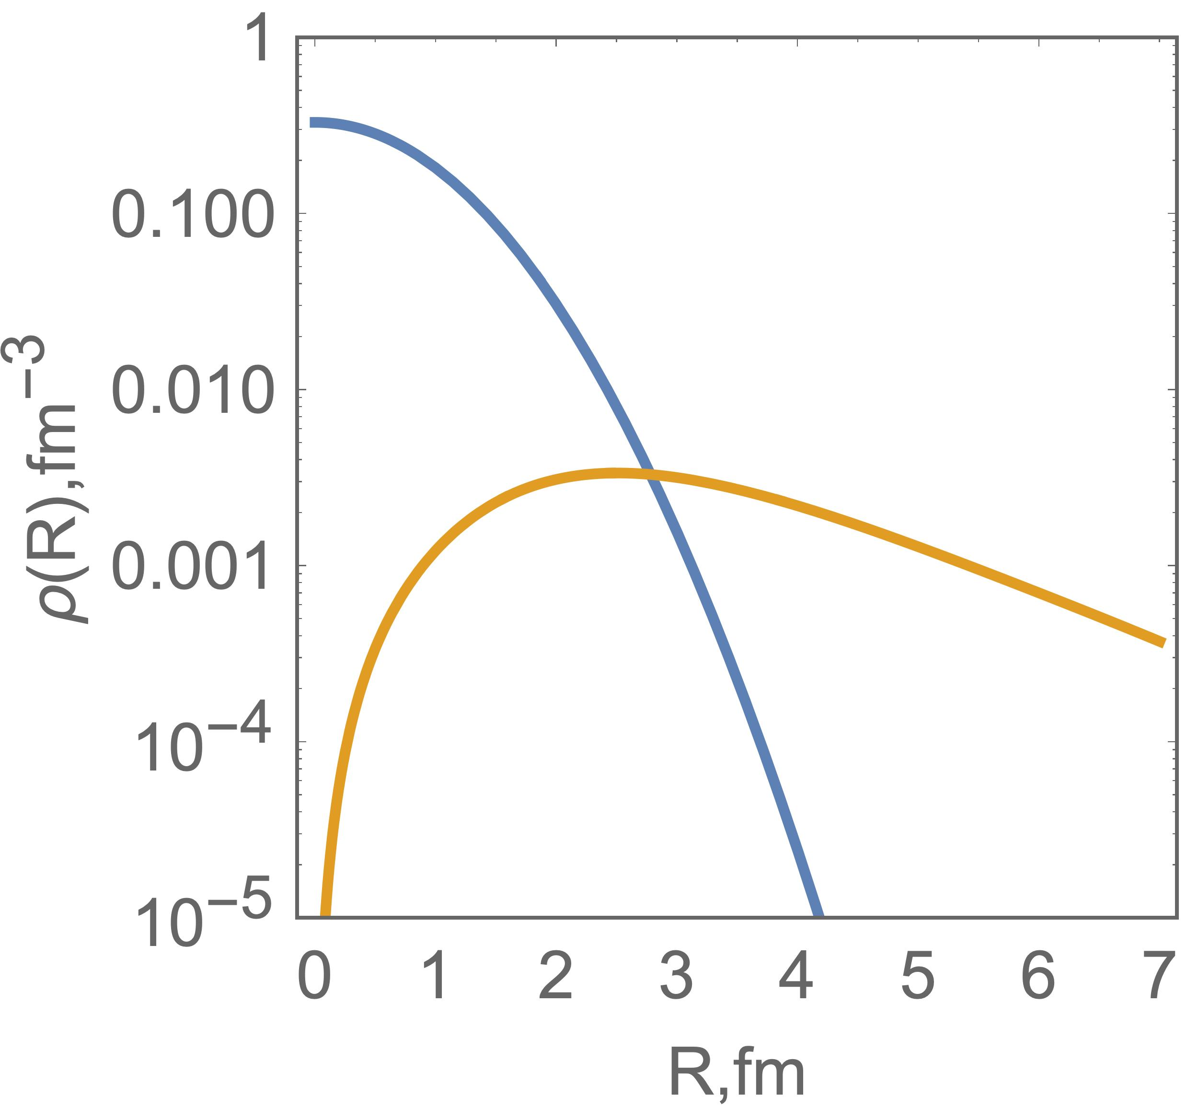
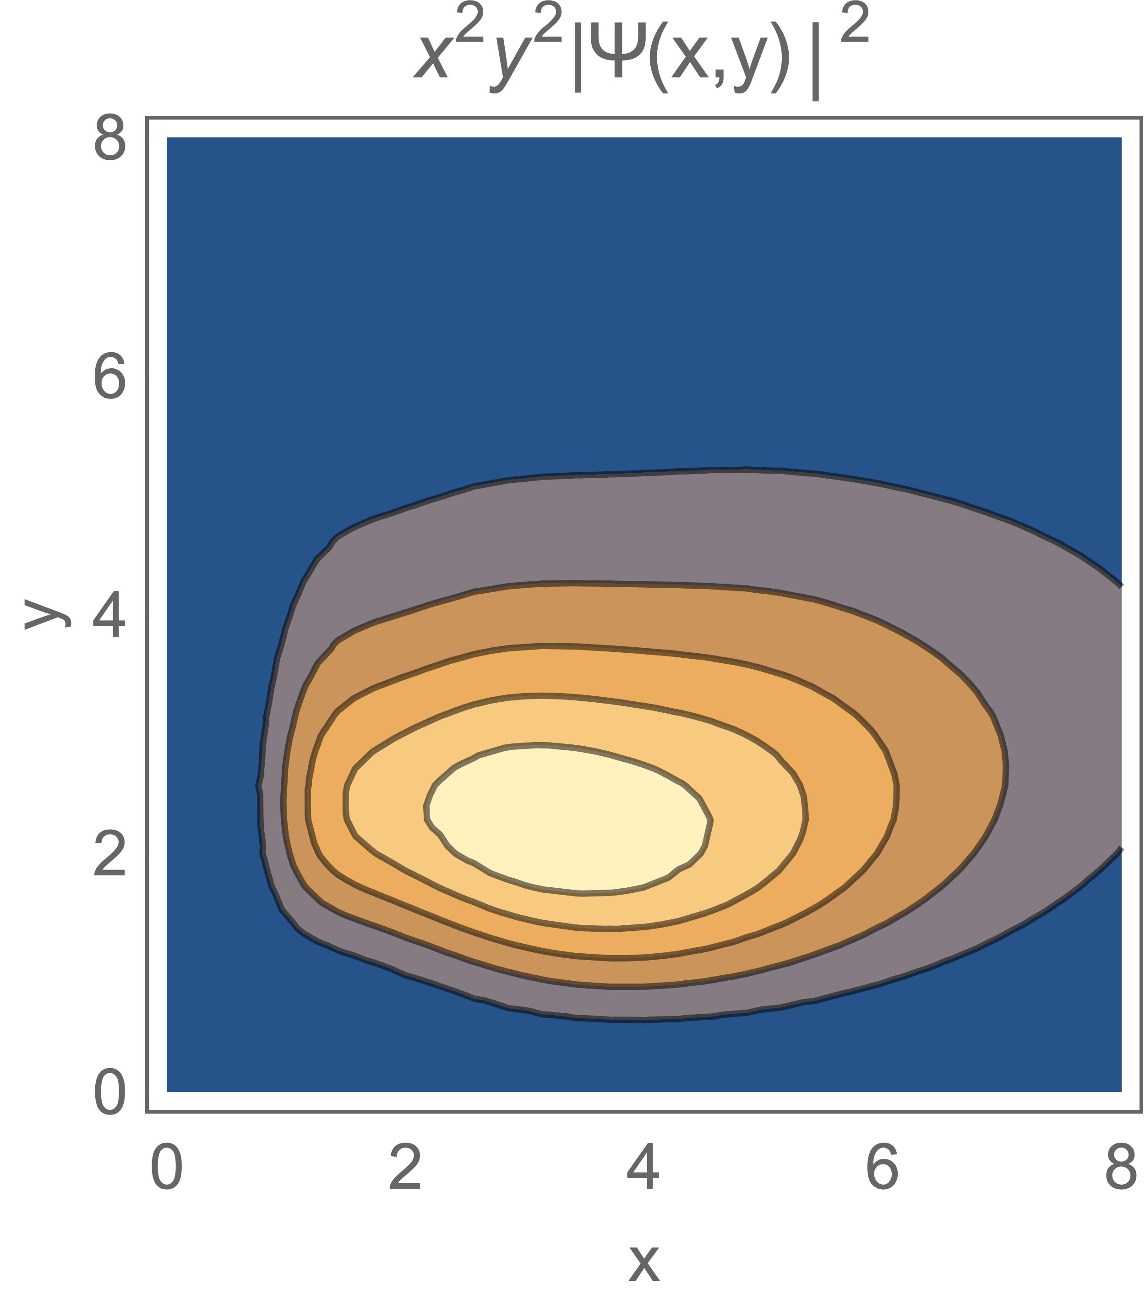
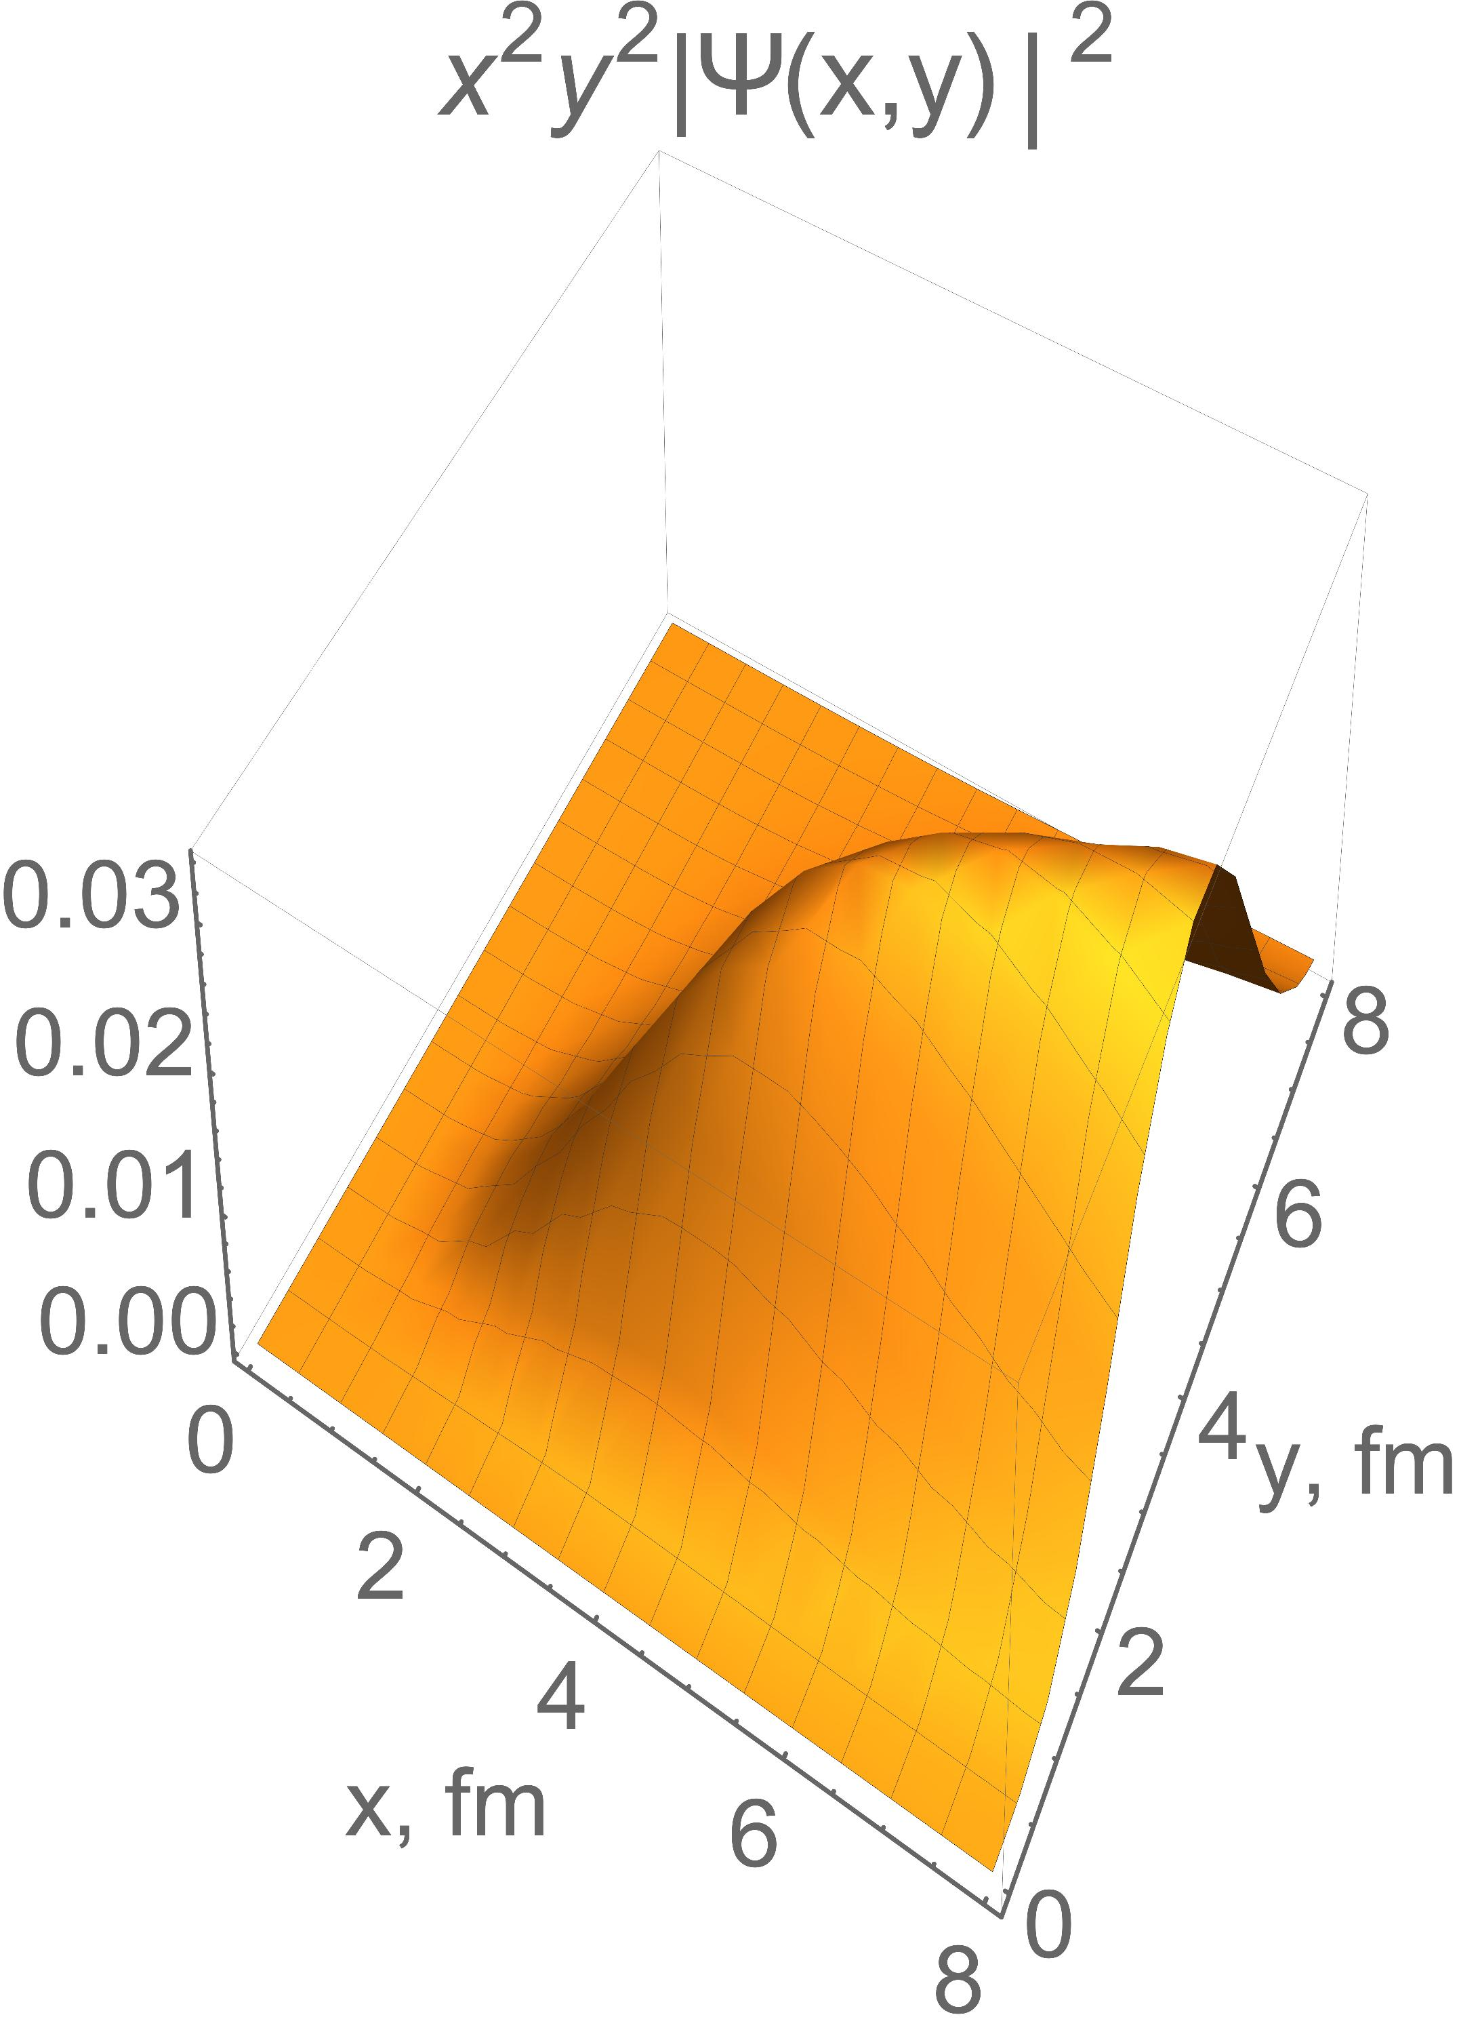
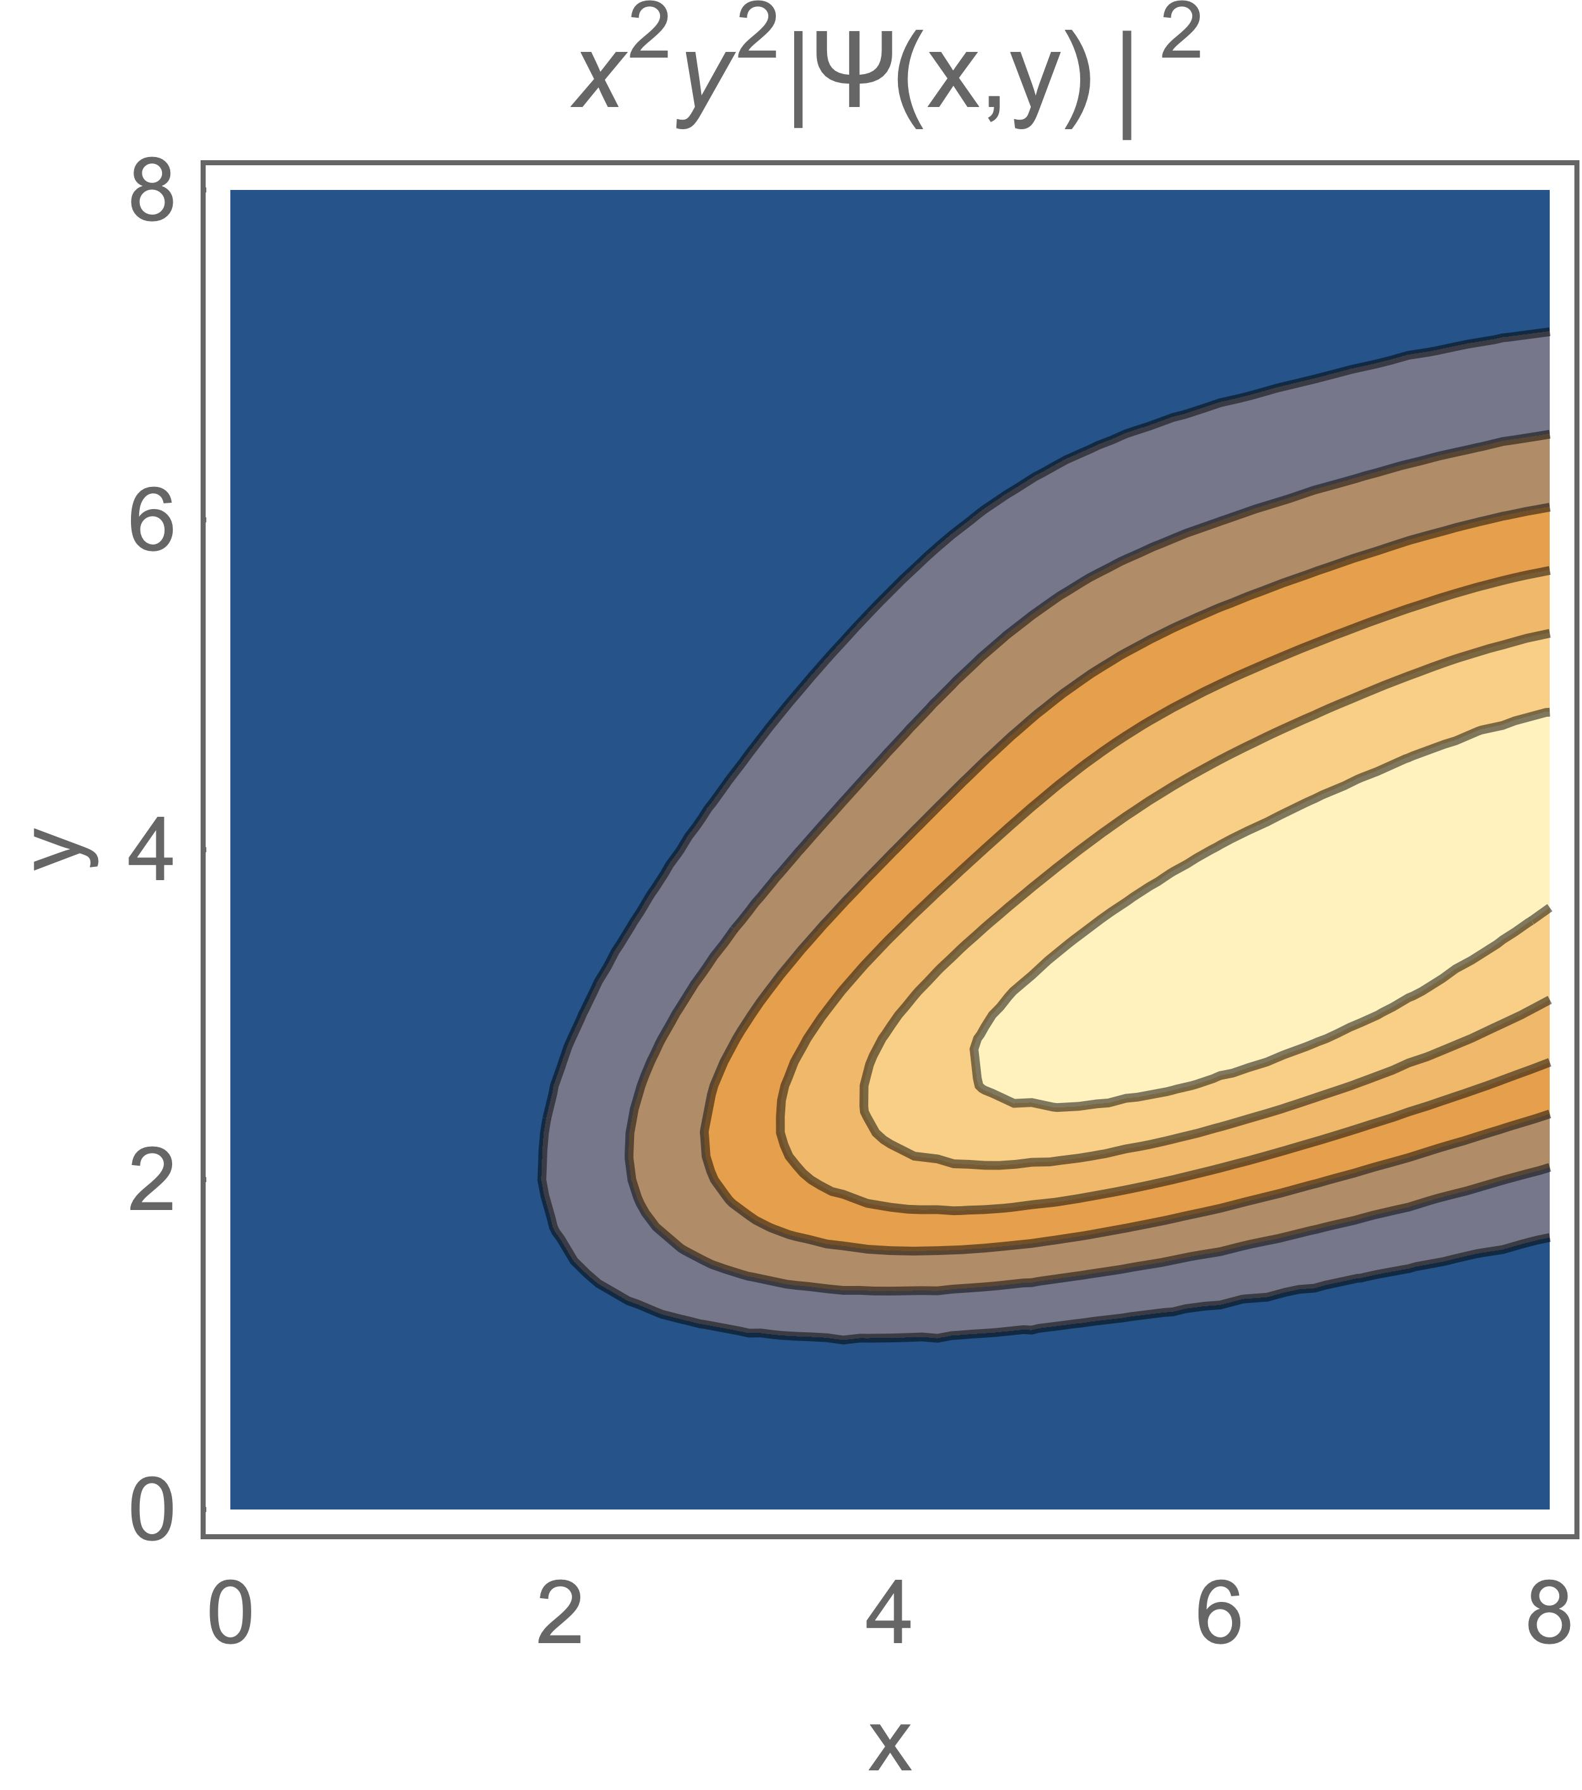
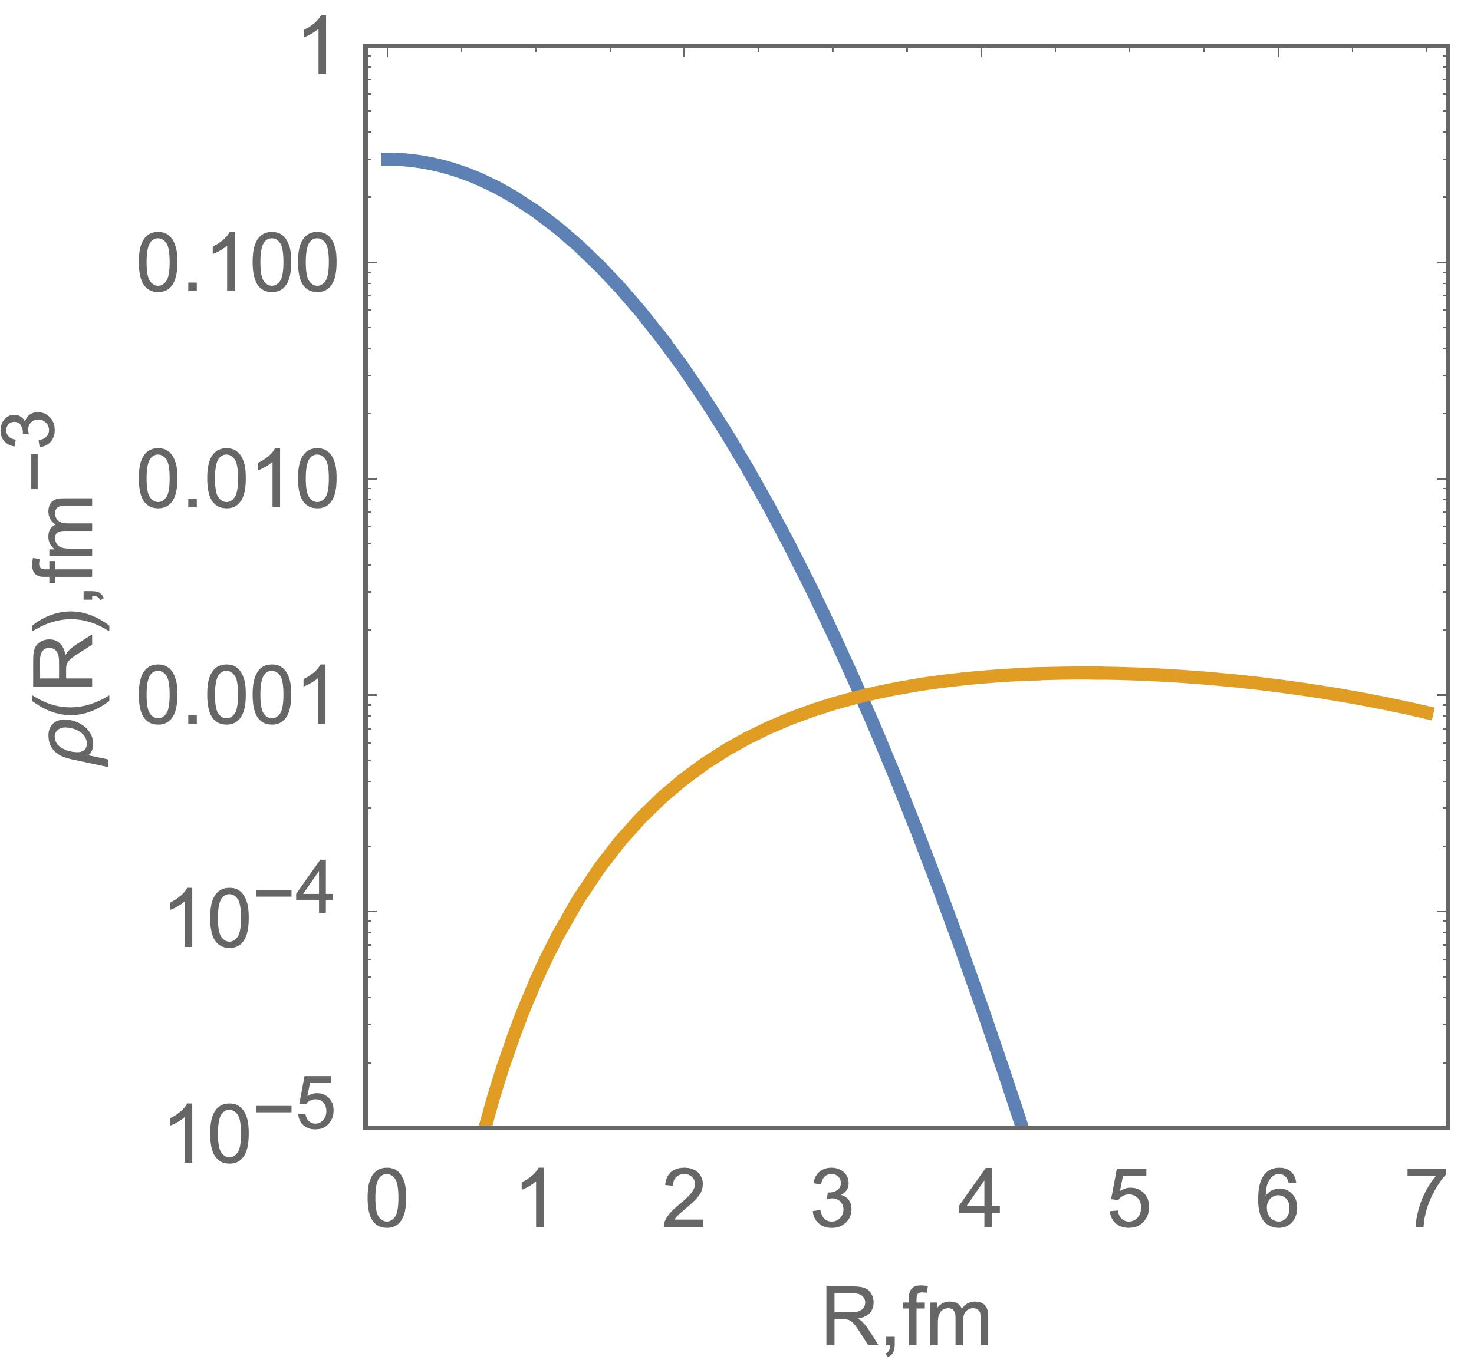
α
⁶He 0⁺
E_{exp} = -0.975 MeV
E_{thr} = -0.228 MeV
<R²_{m}> = 2.83
2Ν
α
⁶He 2⁺
E_{exp} = 0.825 MeV
E_{thr} = 1.842 MeV
<R²_{m}> = 3.13
2Ν
α
⁶He 1⁺
E_{exp} = 4.0 MeV
E_{thr} = 3.947 MeV
<R²_{m}> = 3.70
2Ν

Slide 16
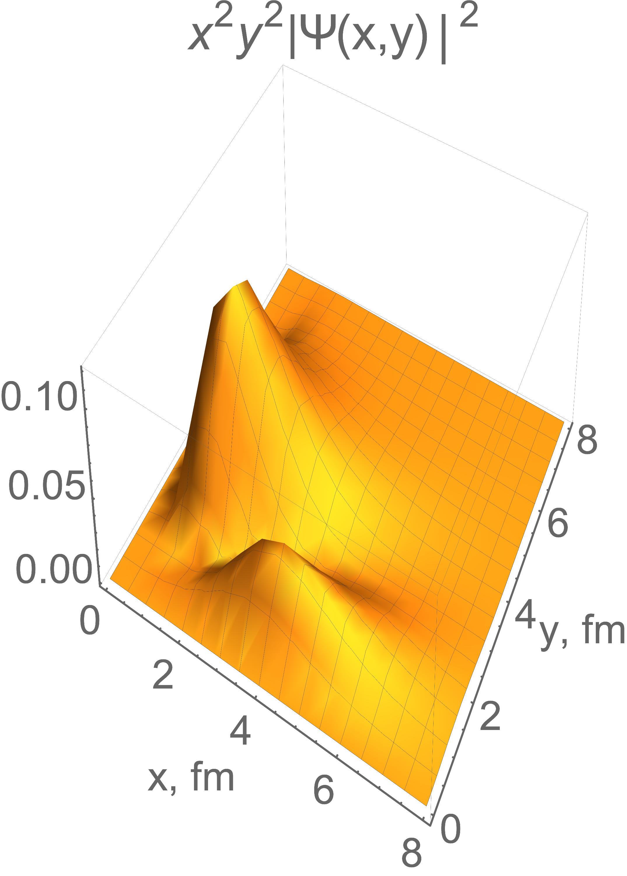
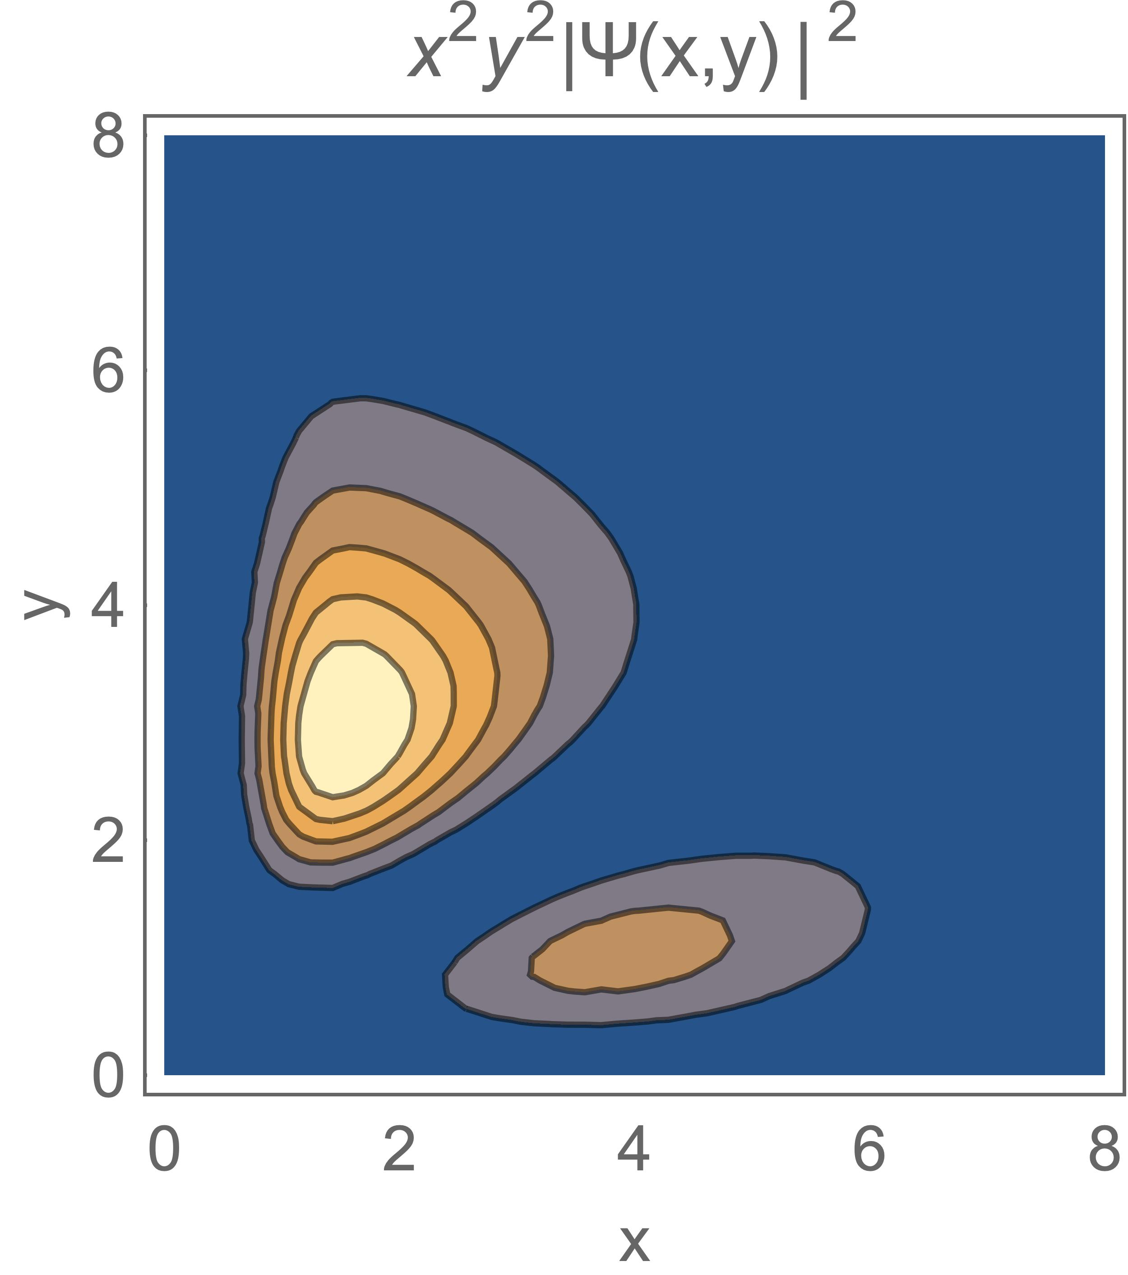
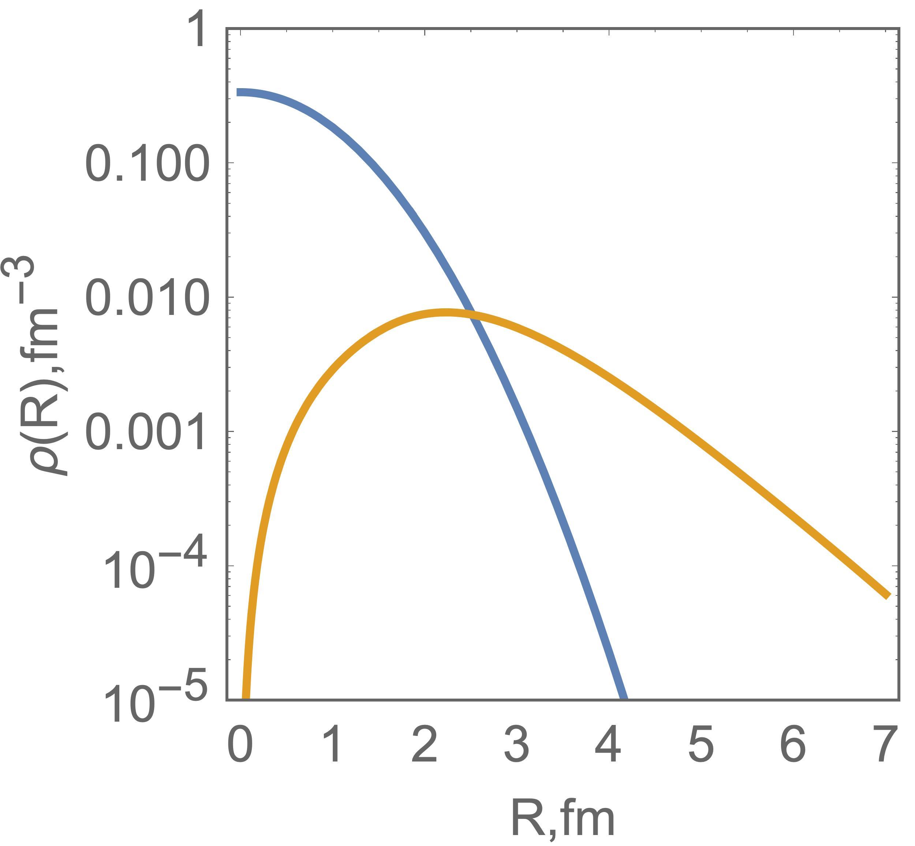
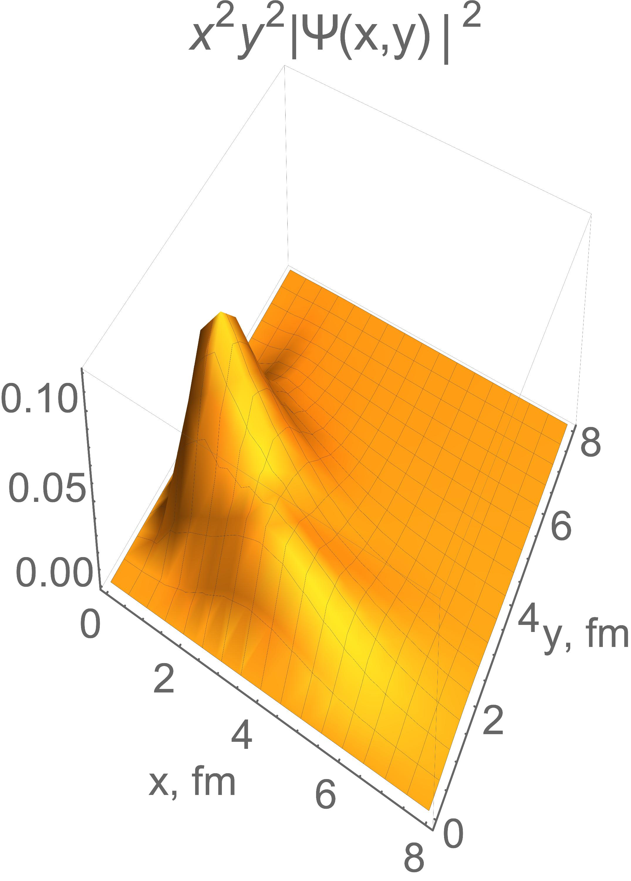
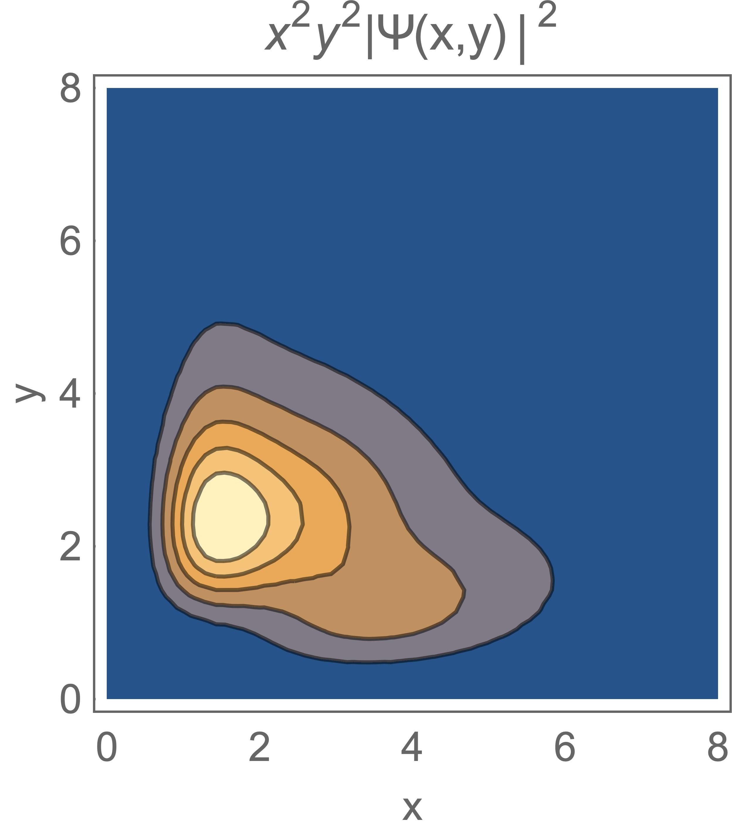
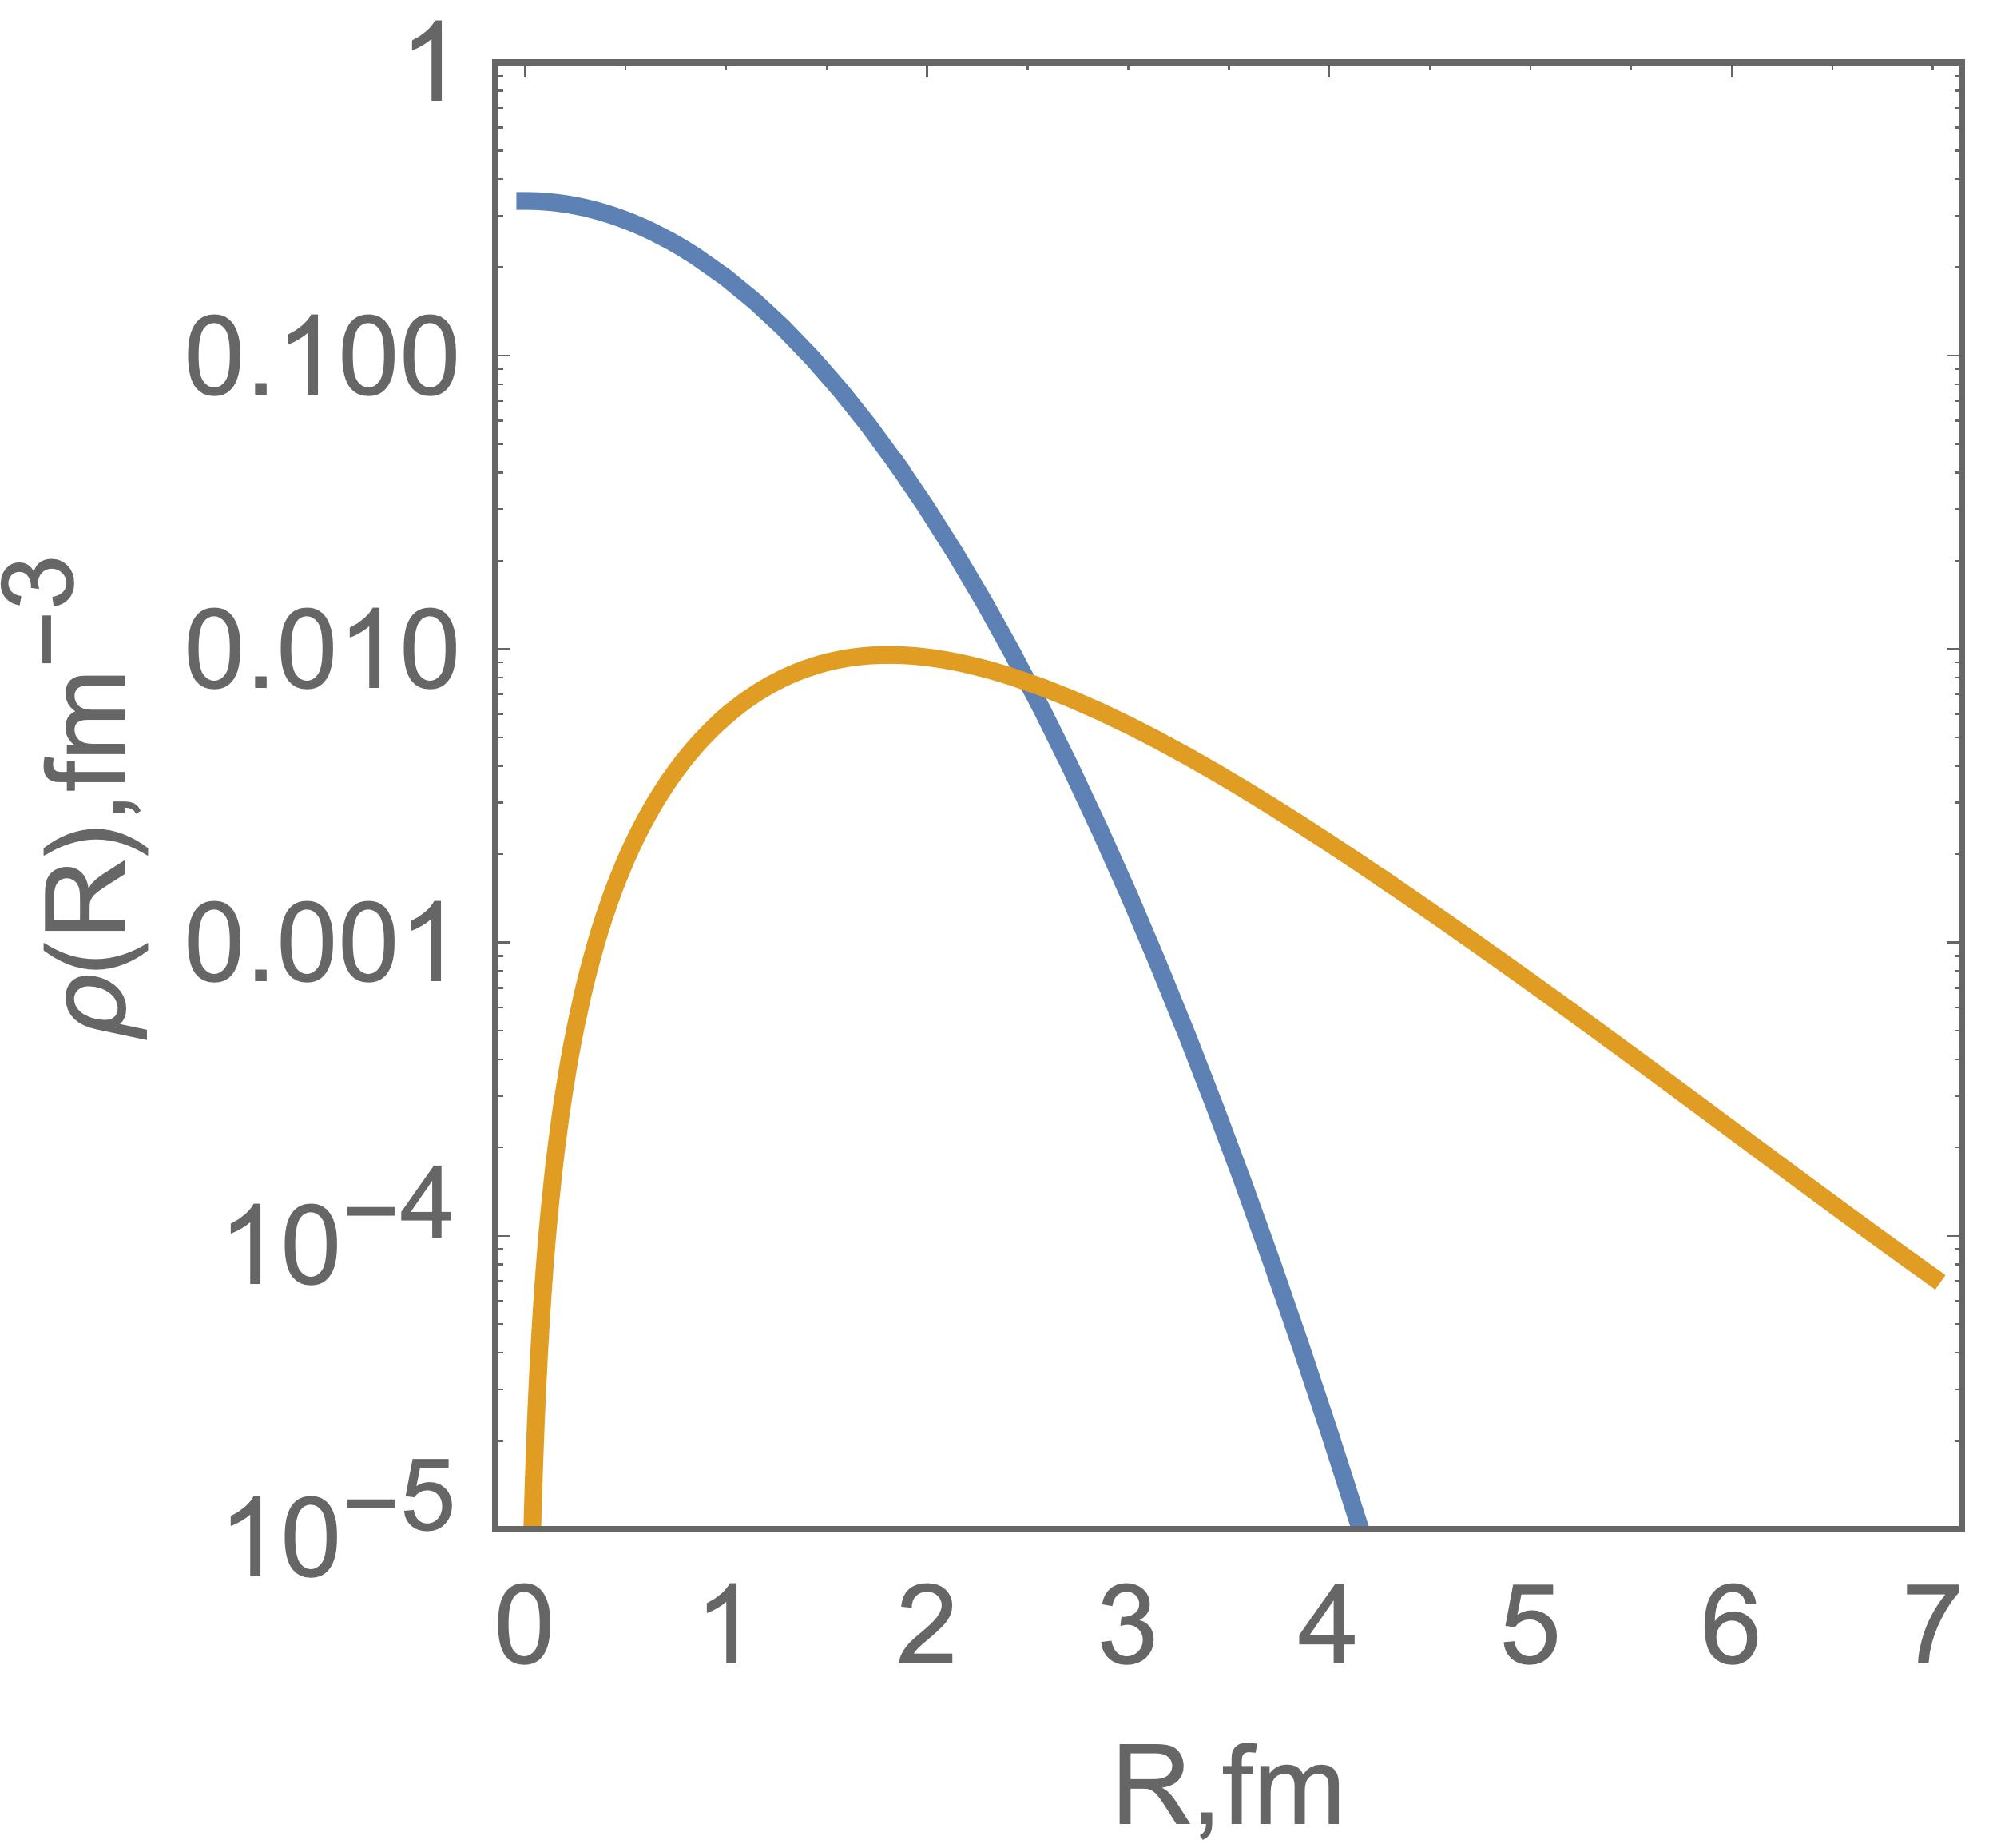
α
⁶Li 1⁺
E_{exp} = -3.700 MeV
E_{thr} = -3.258 MeV
<R²_{m}> = 2.52
2Ν
⁶Li 3⁺
E_{exp} = -1.514 MeV
E_{thr} = -1.714 MeV
α
<R²_{m}> = 2.48
2Ν

Slide 17
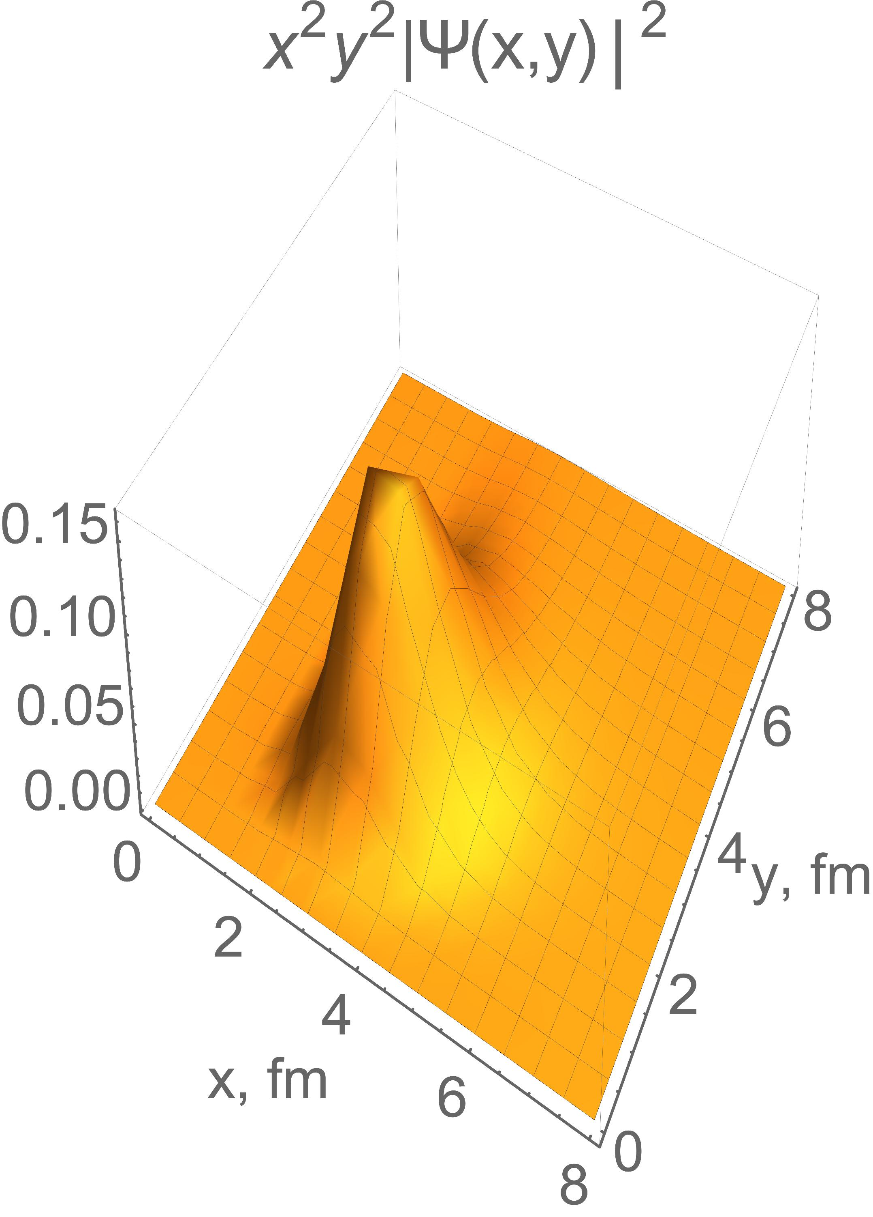
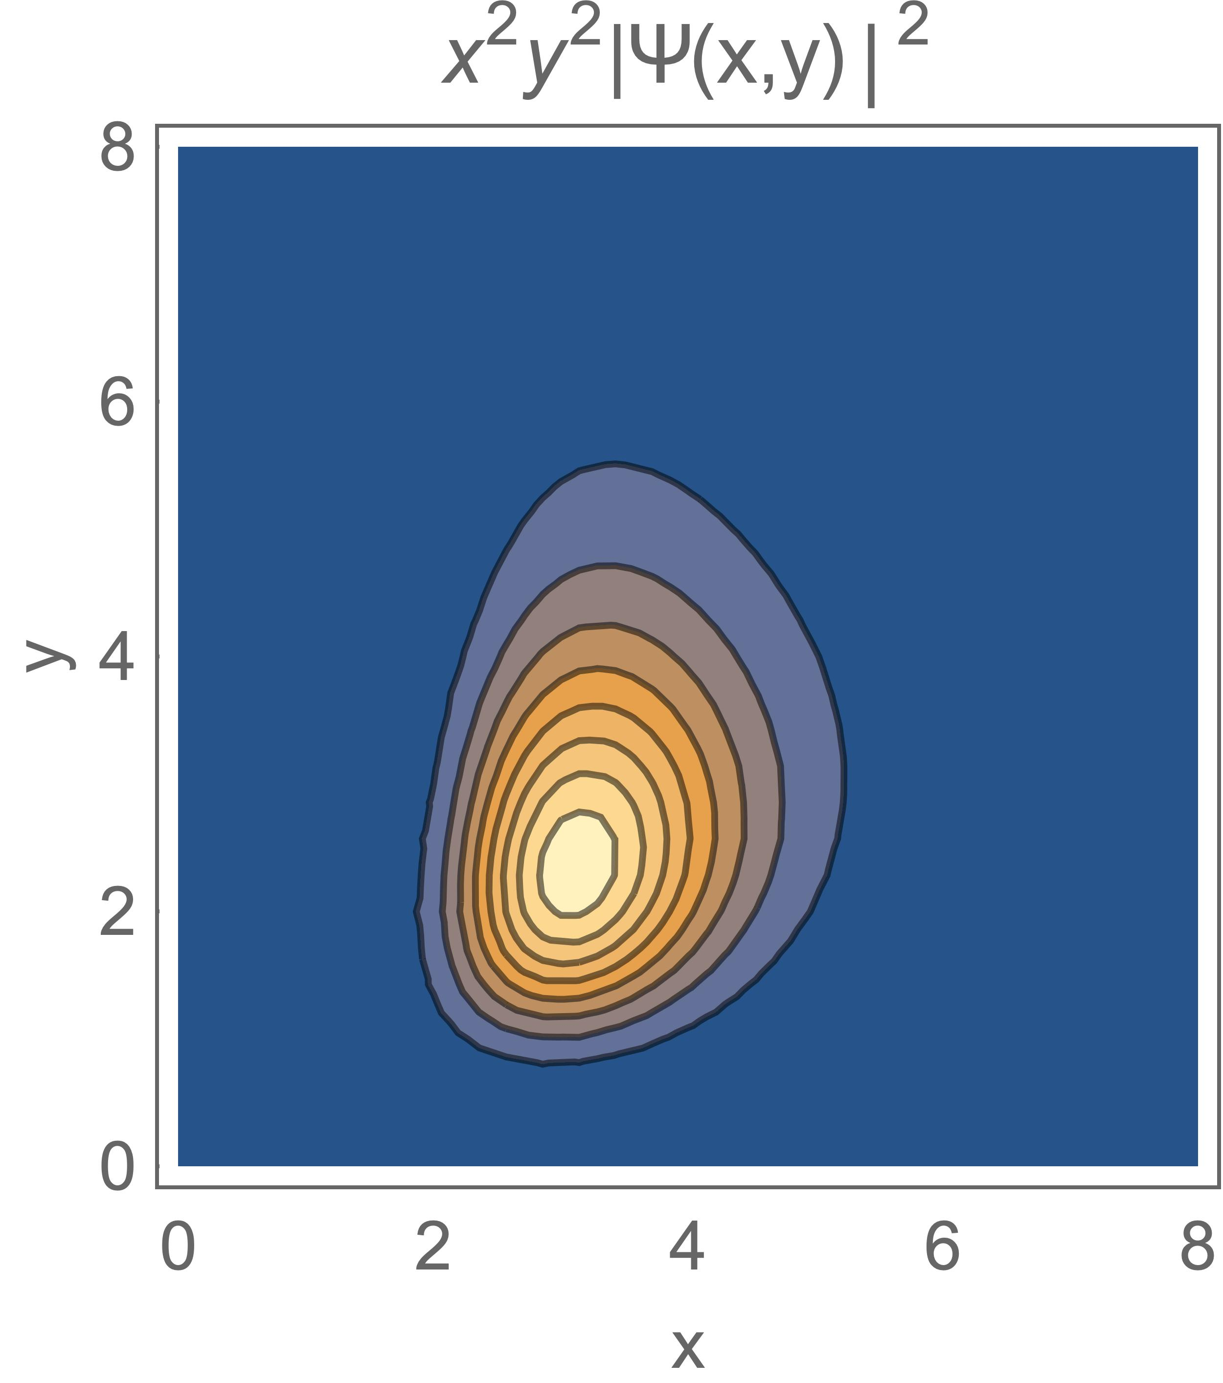
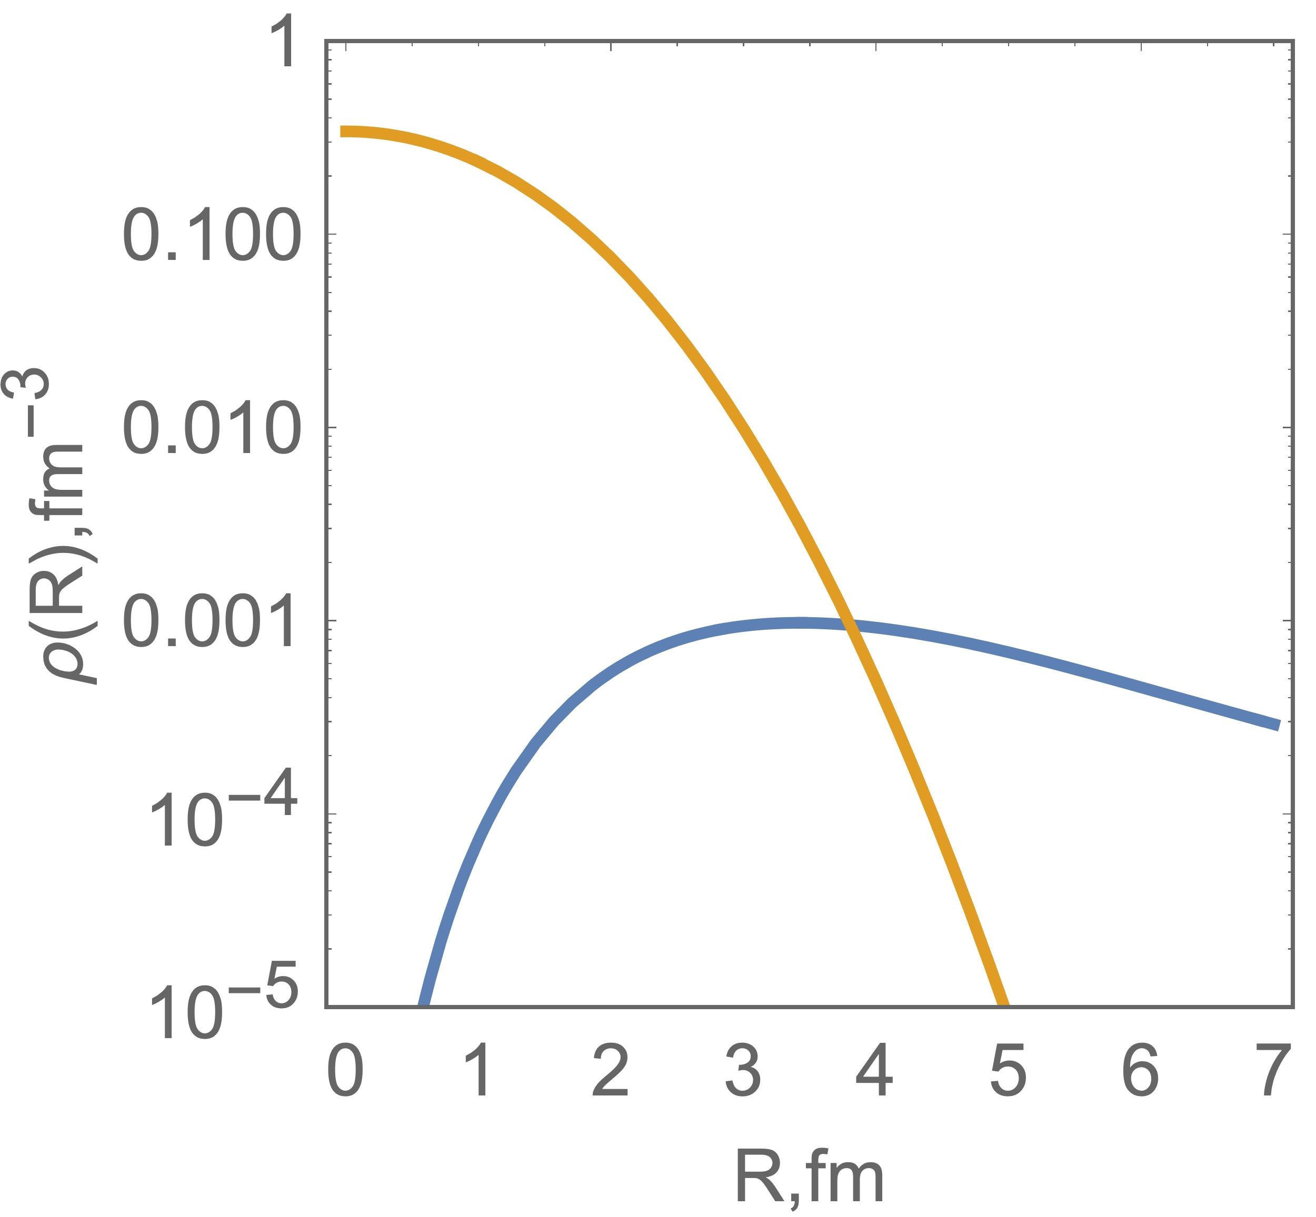
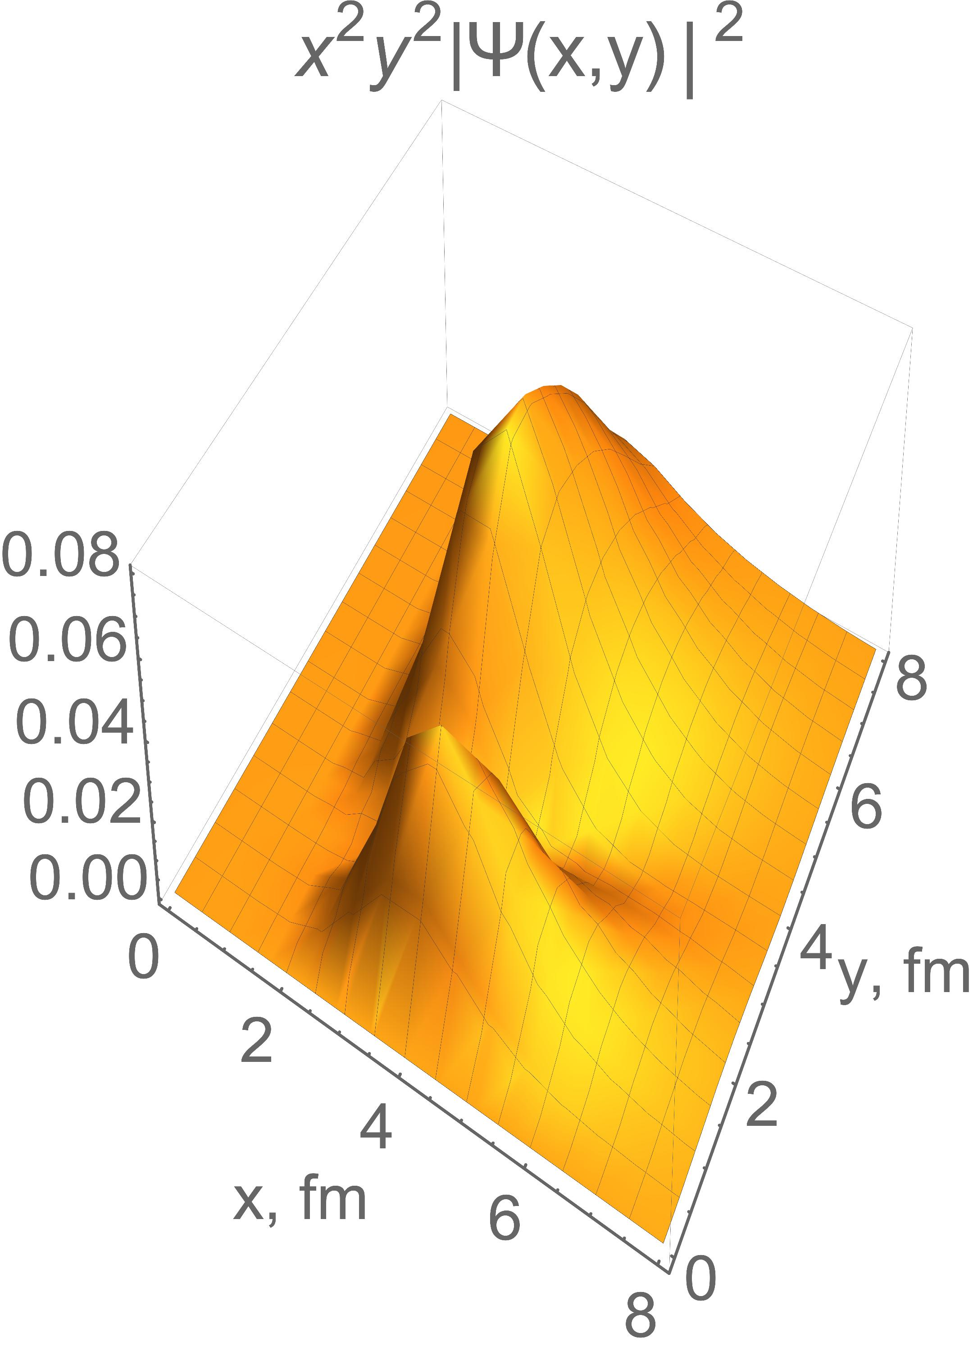
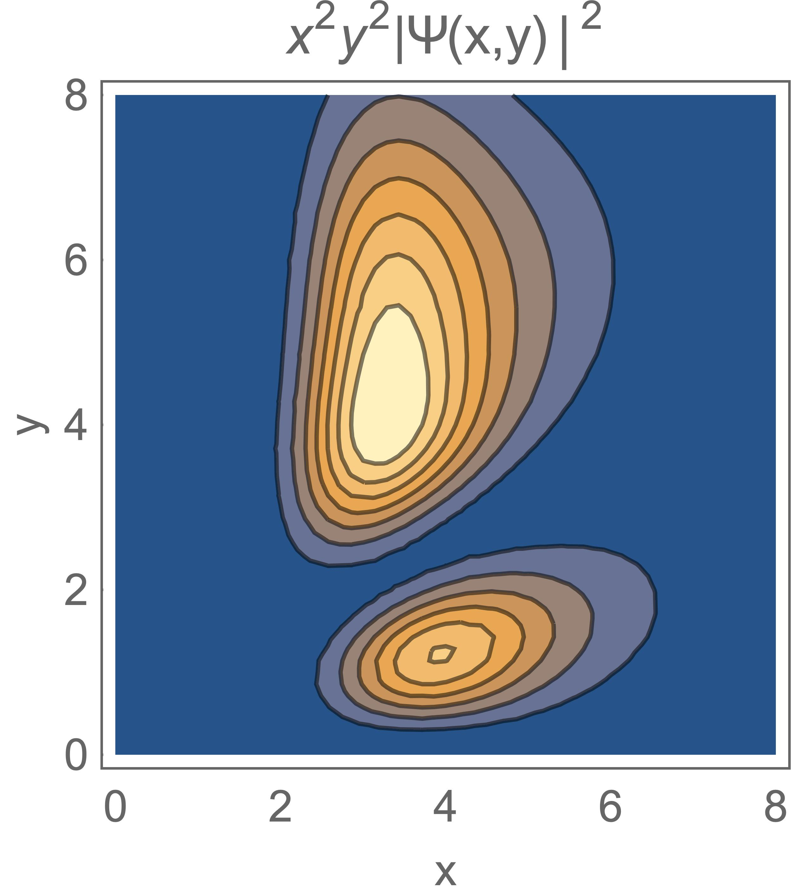
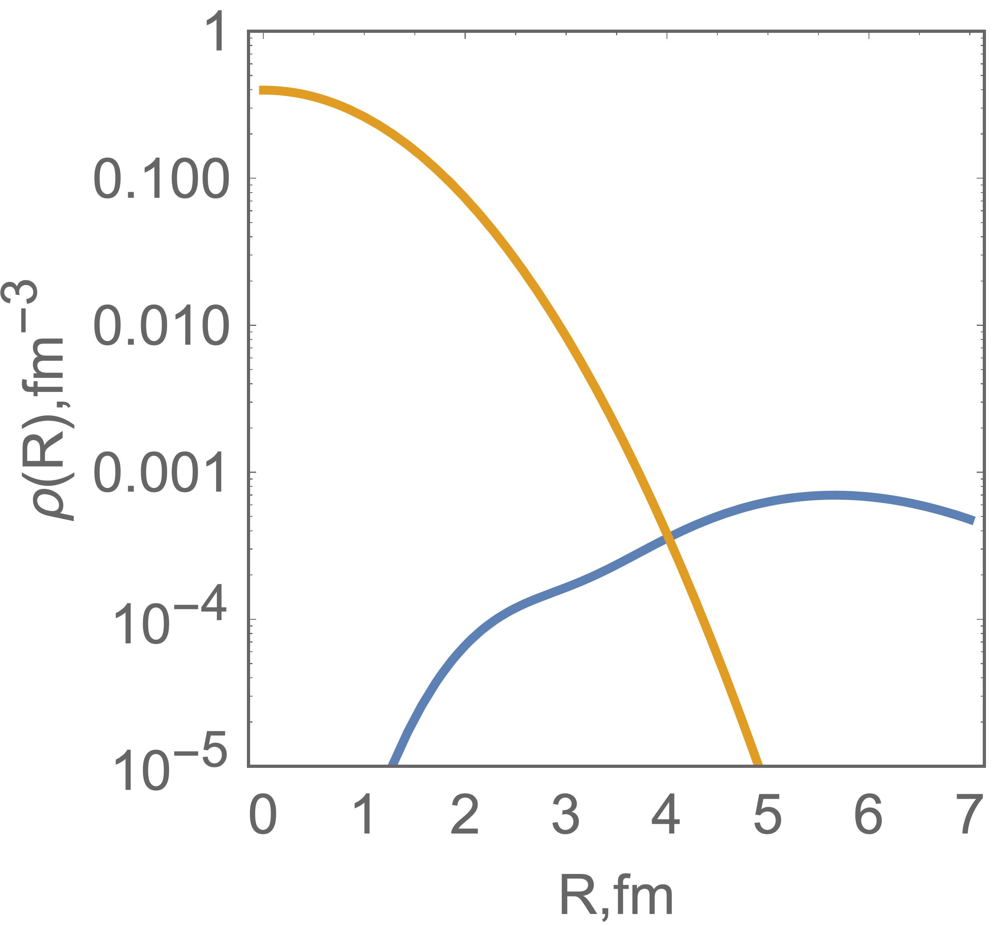
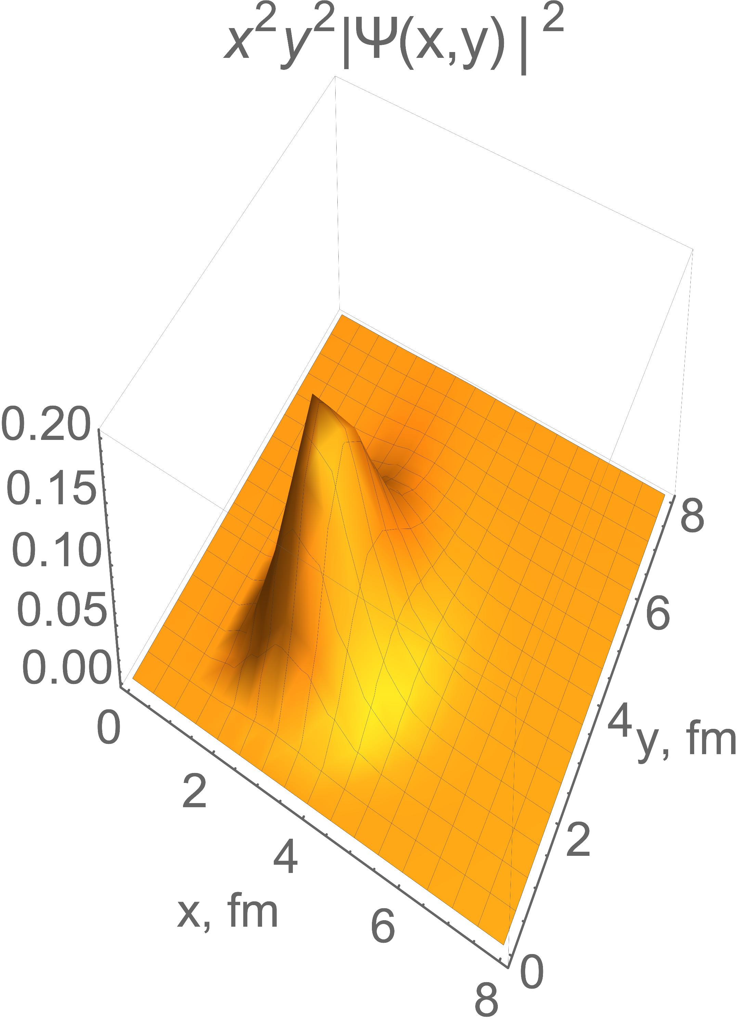
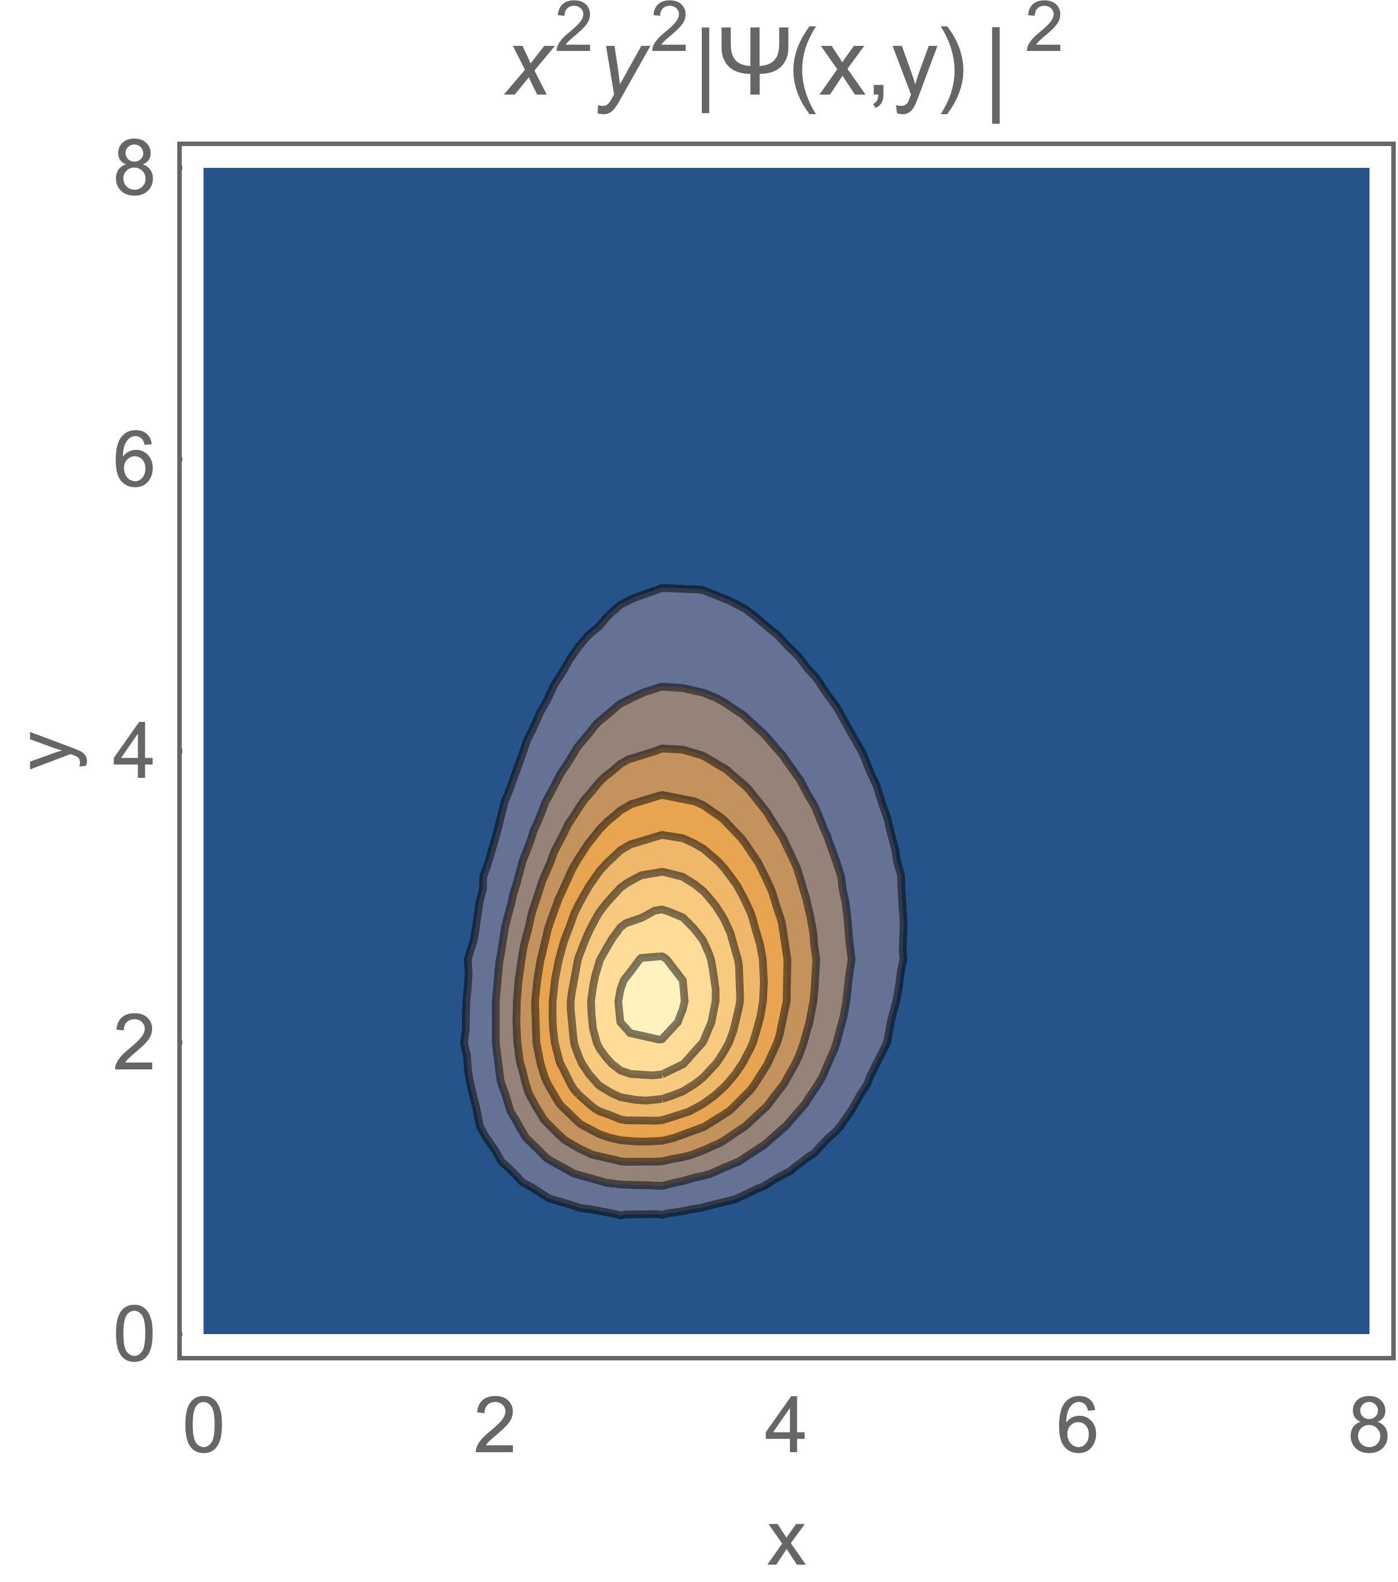
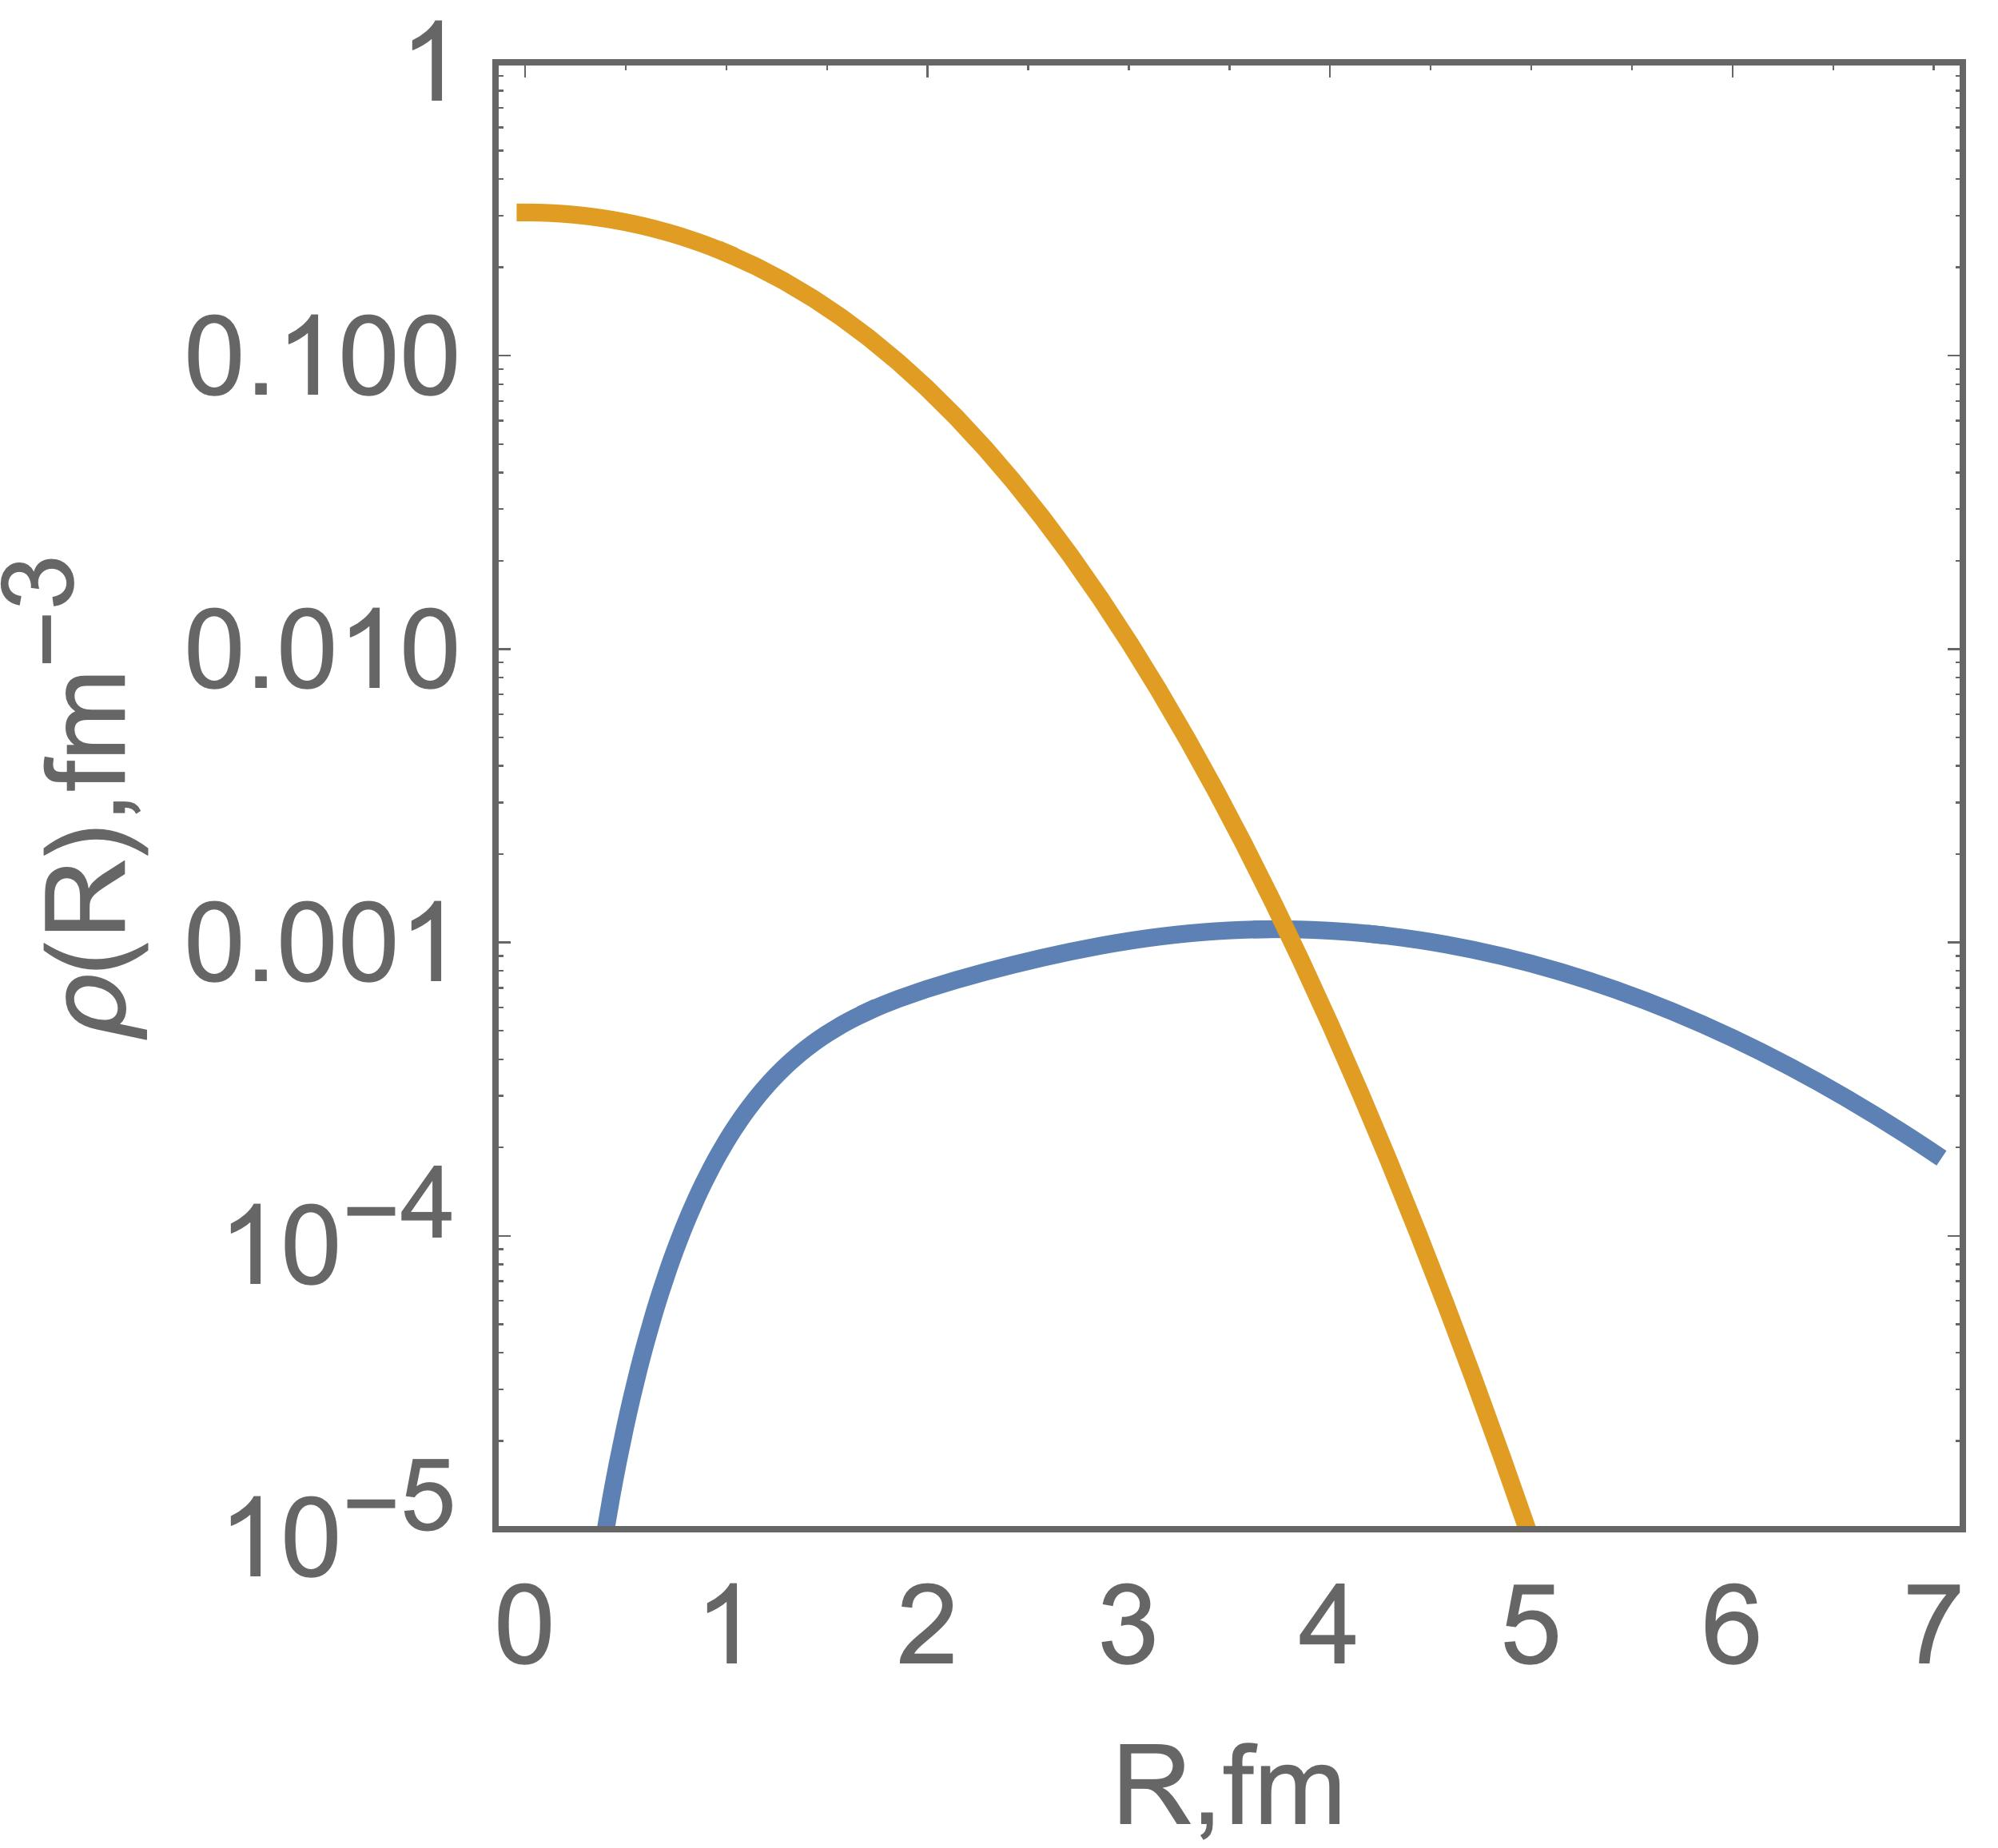
⁹Be 3/2⁻
E_{exp} = -1.57 MeV
E_{thr} = -1.417 MeV
2α
Ν
<R²_{m}> = 2.59
⁹Be 1/2⁺
E_{exp} = 0.11 MeV
E_{thr} = 0.874 MeV
2α
Ν
<R²_{m}> = 2.71
⁹Be 5/2⁻
E_{exp} = 0.86 MeV
E_{thr} = 0.696 MeV
2α
Ν
<R²_{m}> = 2.53

Slide 18
conclusions

Slide 19
Conclutions
The three body model for the ⁶He, ⁶Li and ⁹Be nuclei has been introduced
Analytical expressions of the density distribution function of nuclear matter were deduced for the three body system
Obtained expressions were applied for the ⁶He, ⁶Li and ⁹Be nuclei including ground and low lying excited states
Demonstrated the structures of nuclei in terms of nuclear matter
Taken results may be used for the coupling potentials in the Coupled Reaction Channels calculations

Slide 20
Thank you for your attention

